Slide 1
Prioritizing Cycle Infrastructure Based on Potential Demand
I use Manchester as an example but the analysis Is automated to run on any city in the UK

Slide 2
What Is The Current Mode Share?

Slide 3
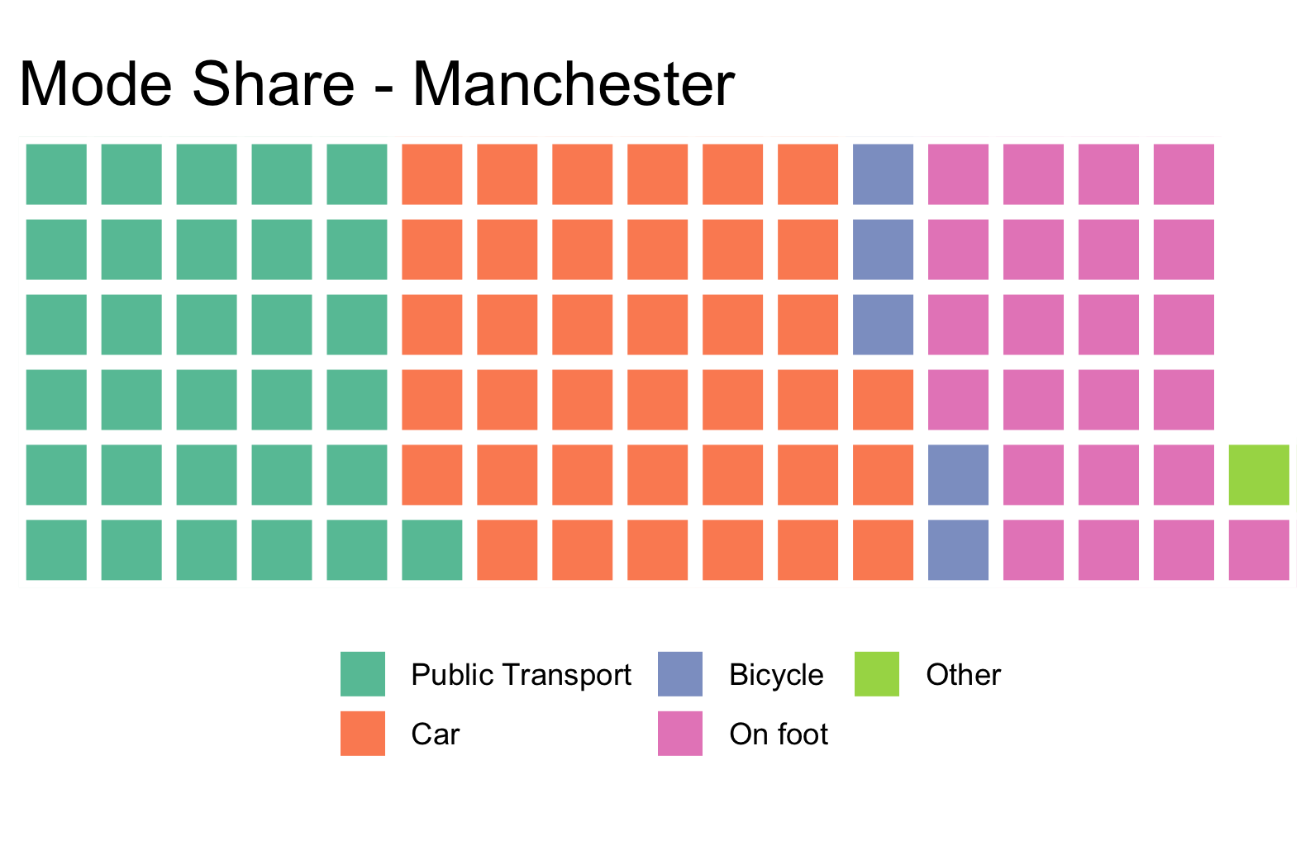
1 box = 1%

Slide 4
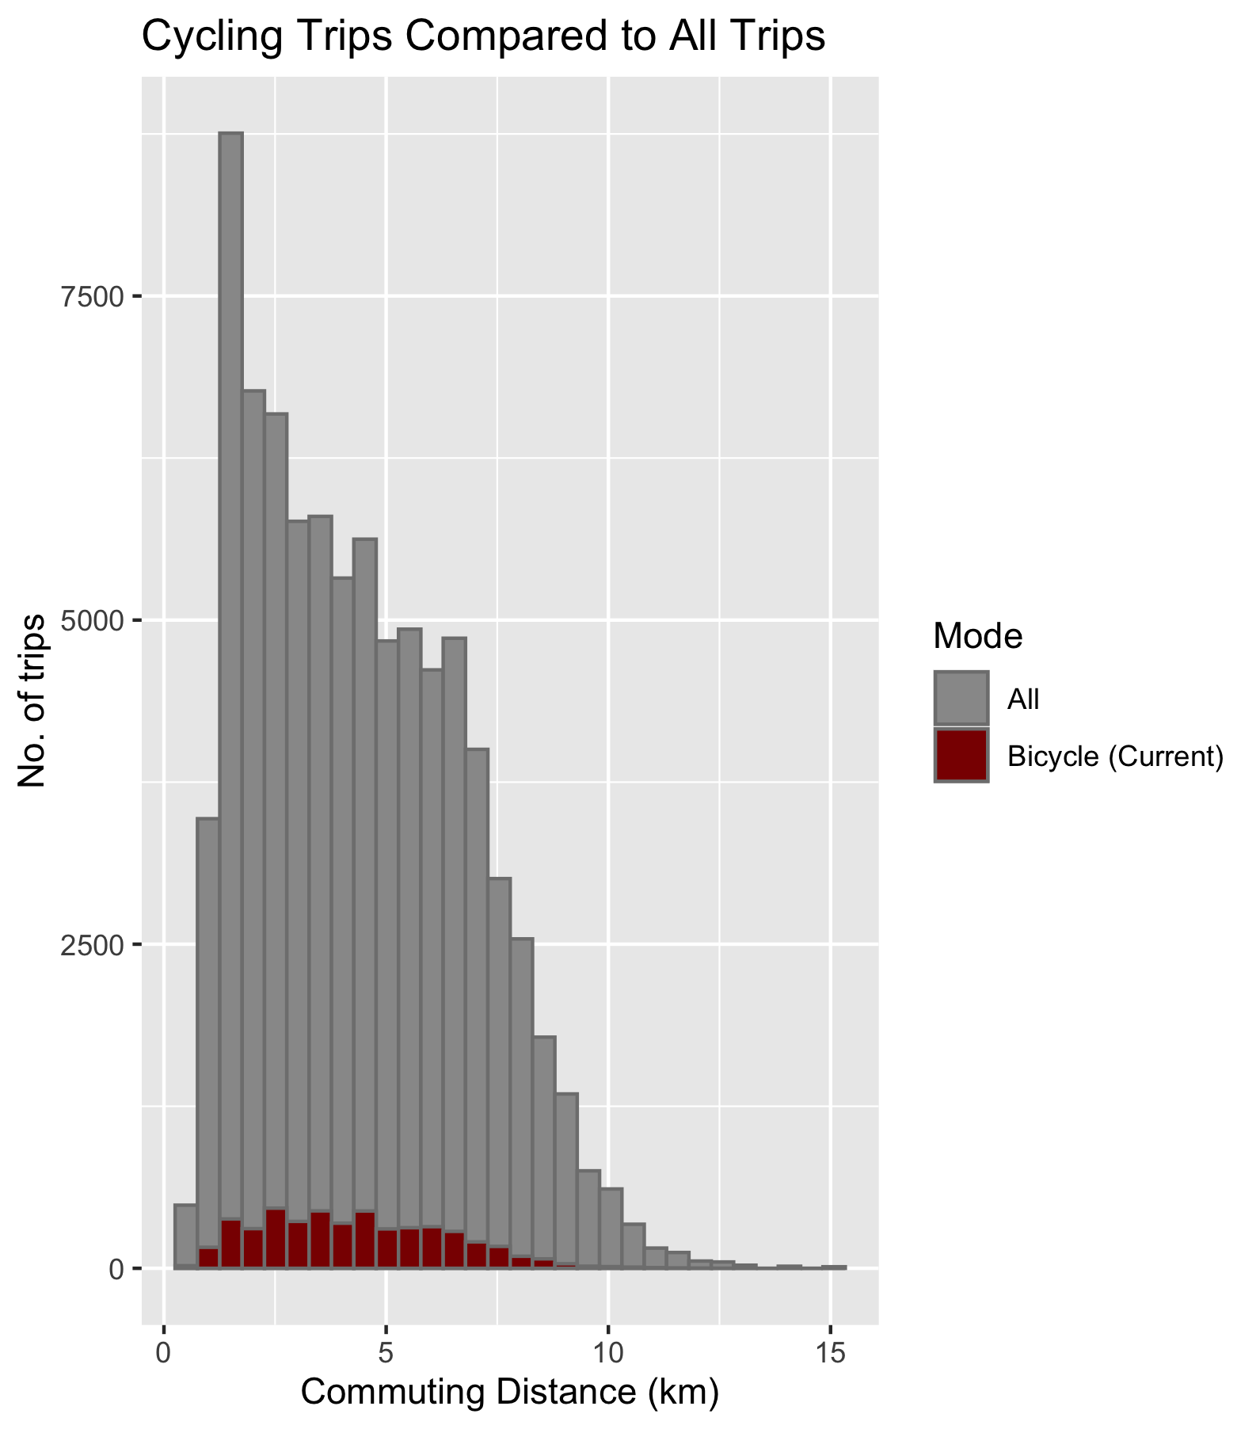
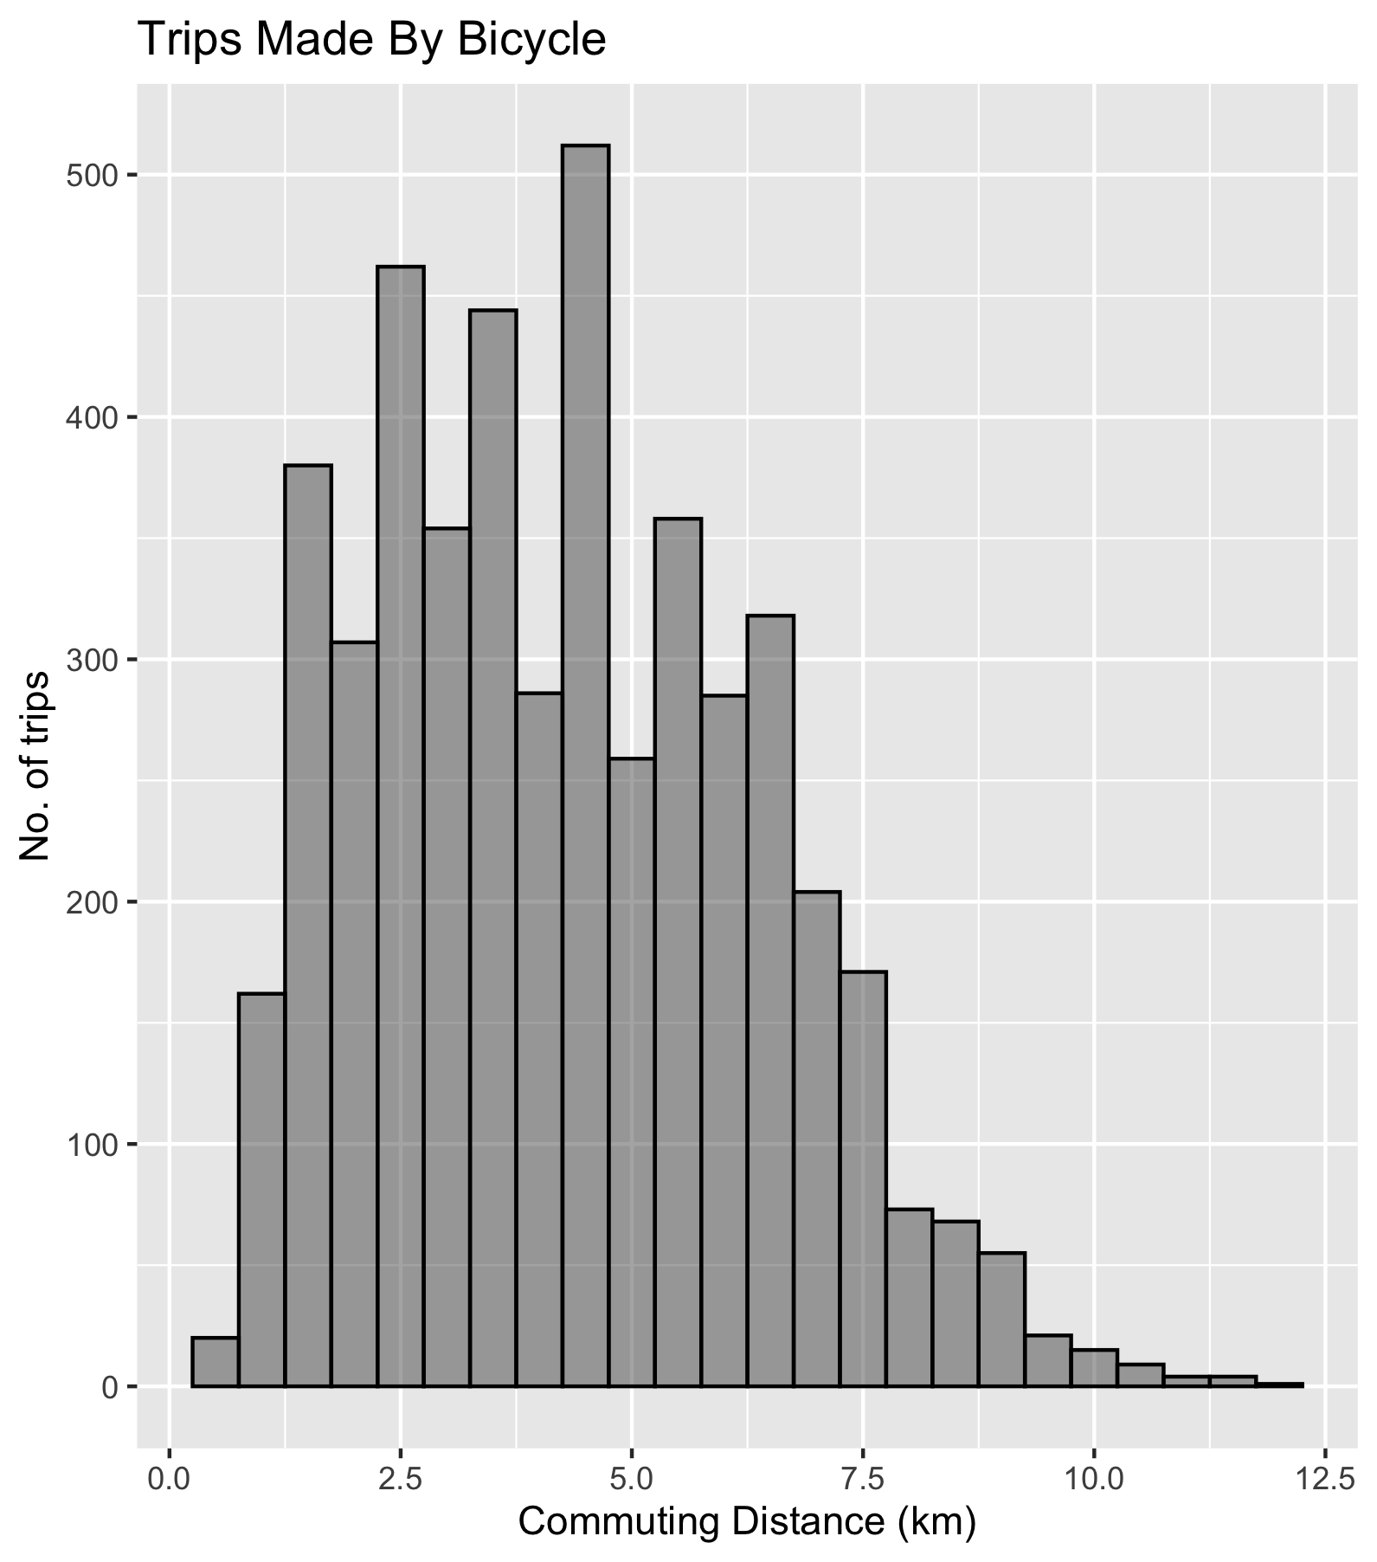

Slide 5
Let’s Look at Cycling Mode Share: How Are Different OD Pairs Performing Relative to the Average Flow for Their Distance?
Ratio = Cycling Mode Share / Average Cycling Mode Share for Distance Group*
*OD pairs are bucketed into 1km groups (1-2km, 5-6km……)

Slide 6
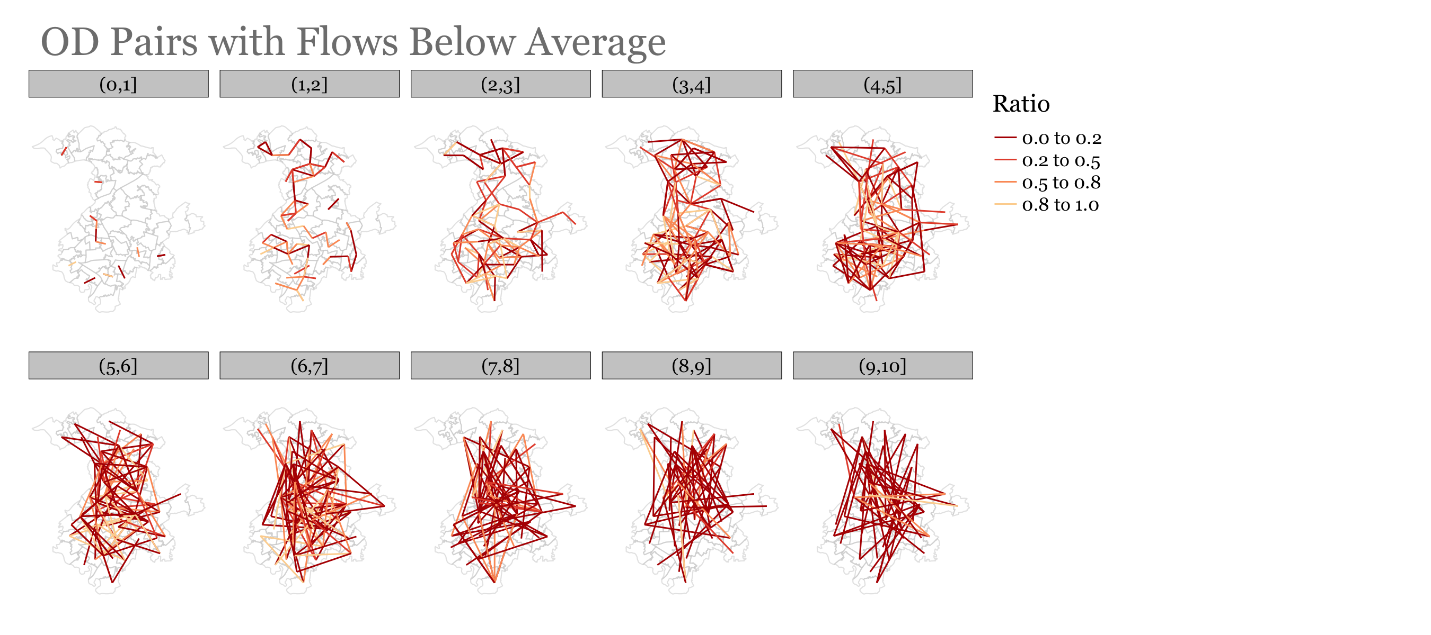

Slide 7
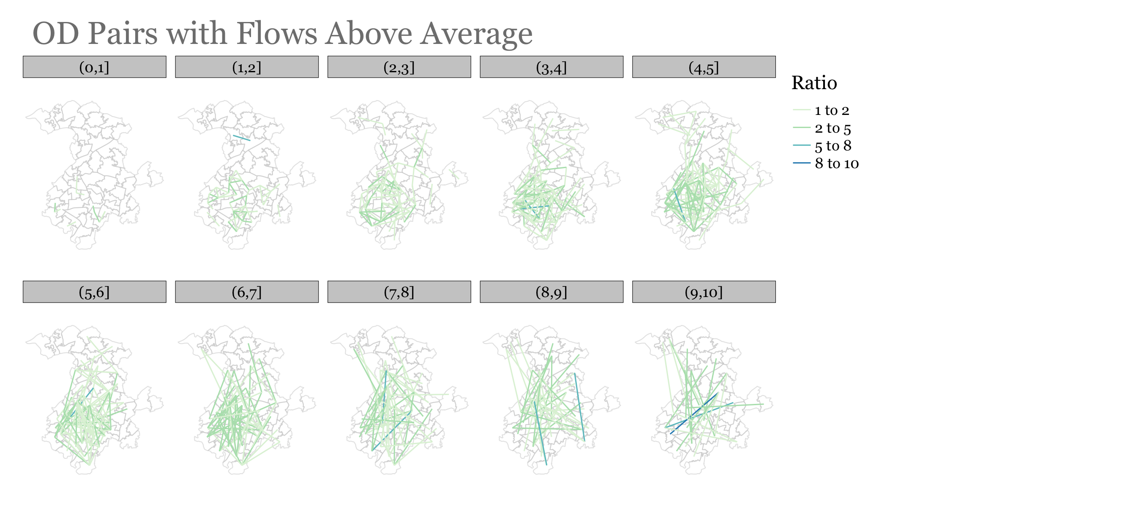

Slide 8
How Would An Increase In Cycling Mode Share Be Distributed Between The Different OD Pairs?

Slide 9
How to Distribute Additional Cycling Mode Share
We cannot increase the mode share for each OD by the same X%
We use a distance decay function:
Cycling Increase -> f(distance, slope)
Next slides show how a 15% increase in cycling mode share would be distributed. The new cycling mode share is referred to as ‘potential’

Slide 10
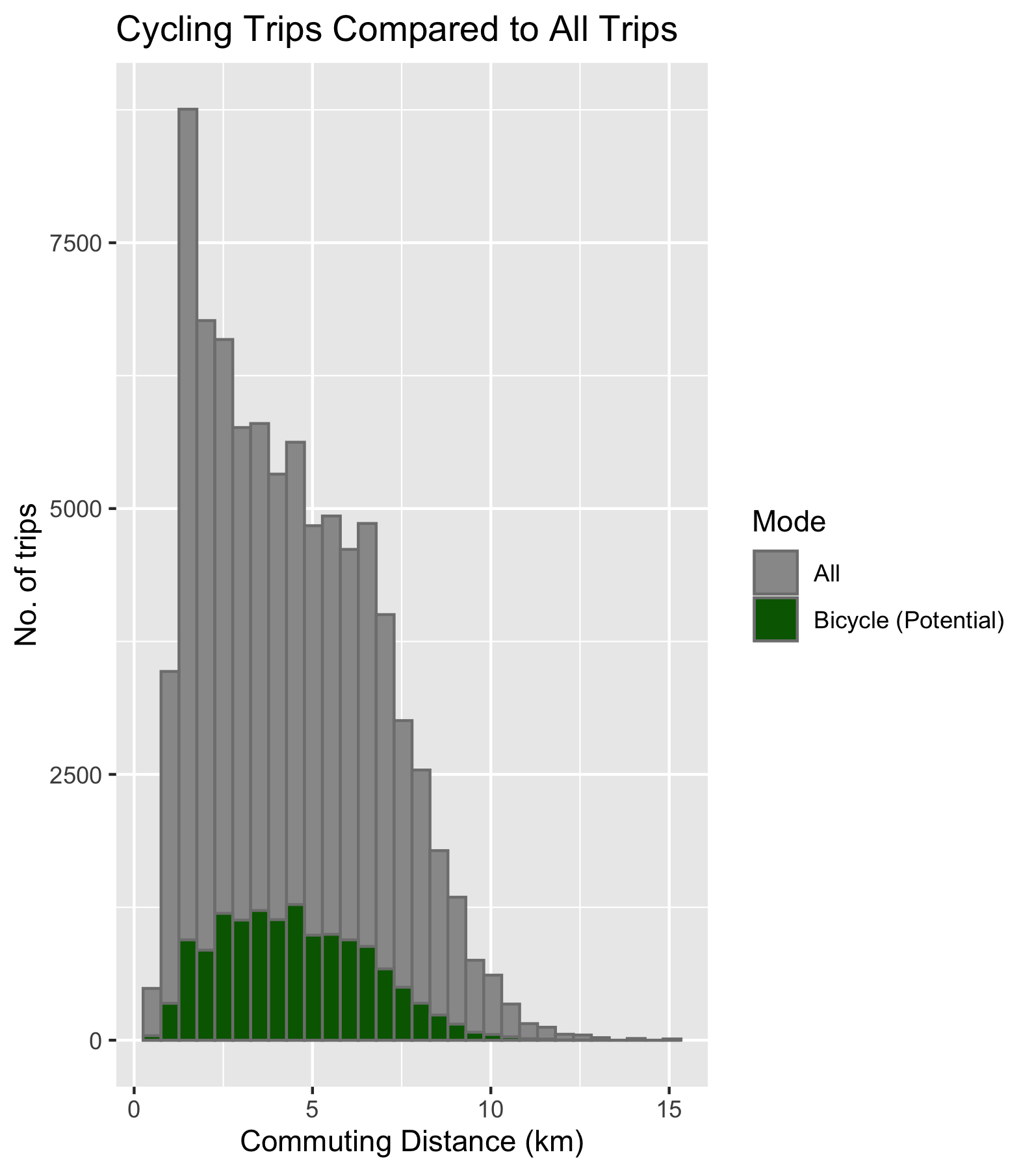

Slide 11
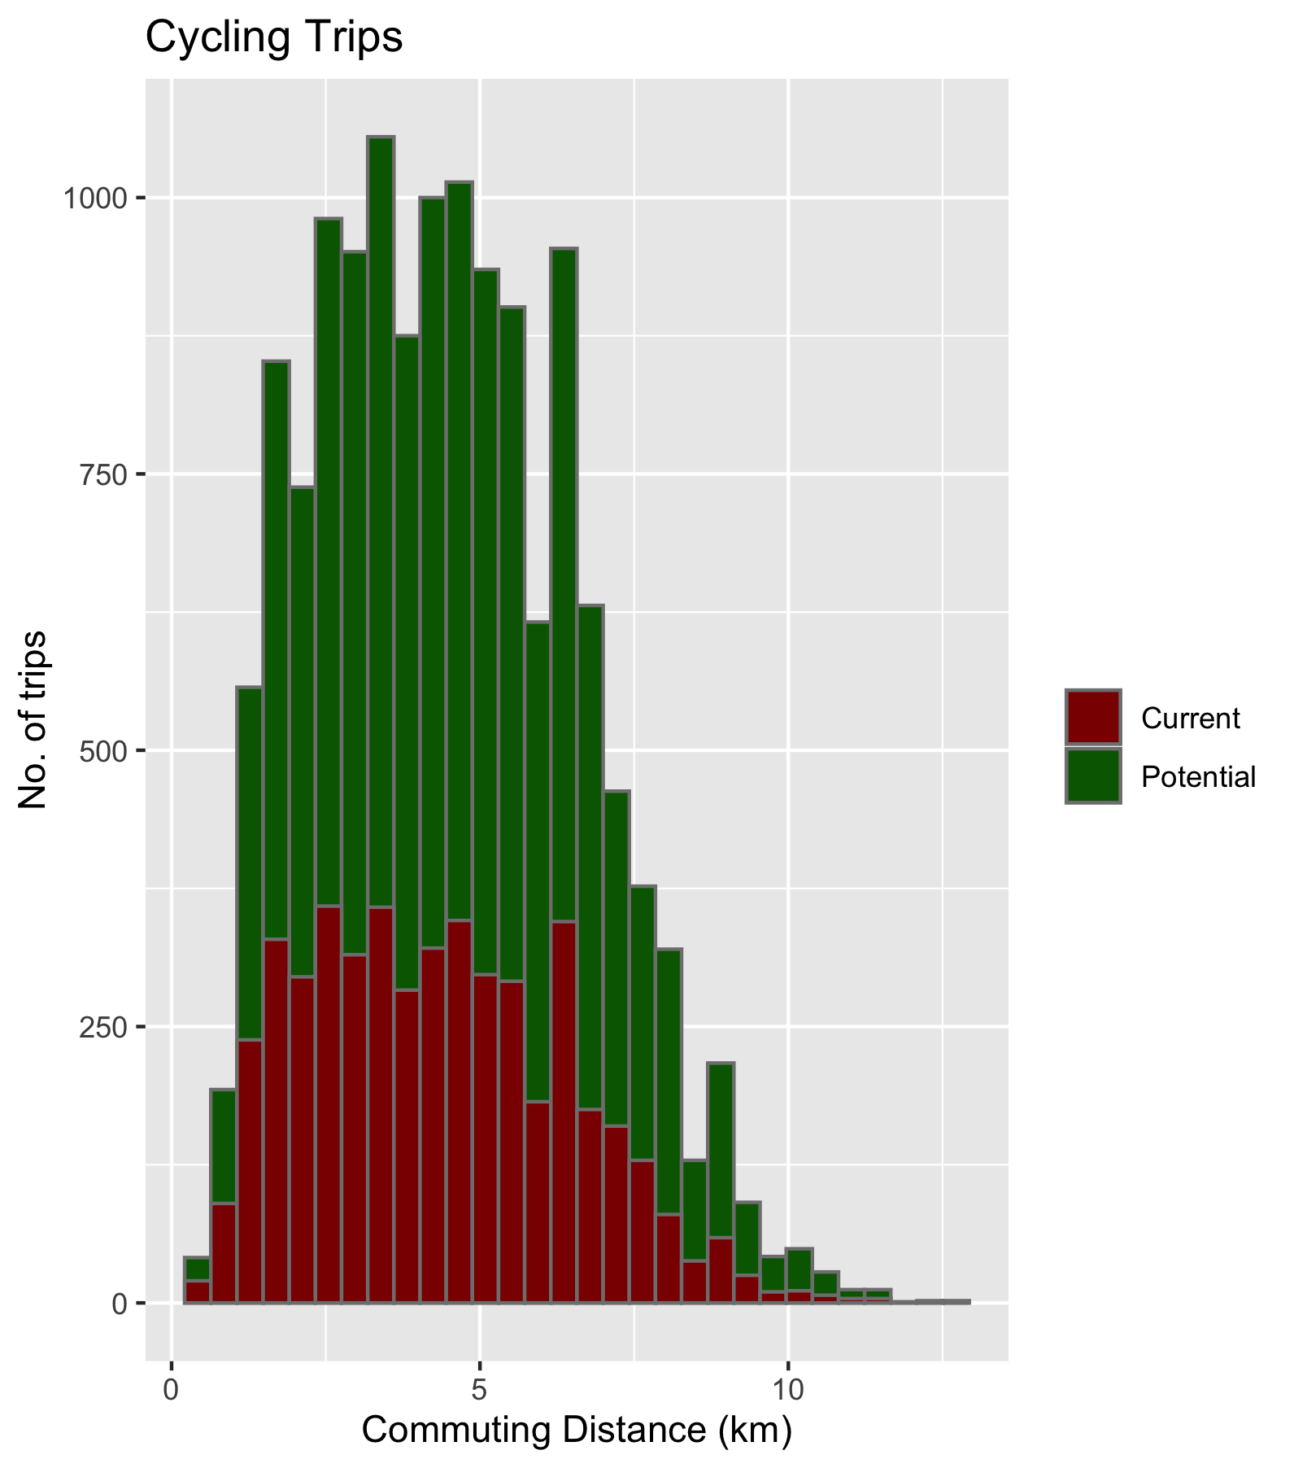
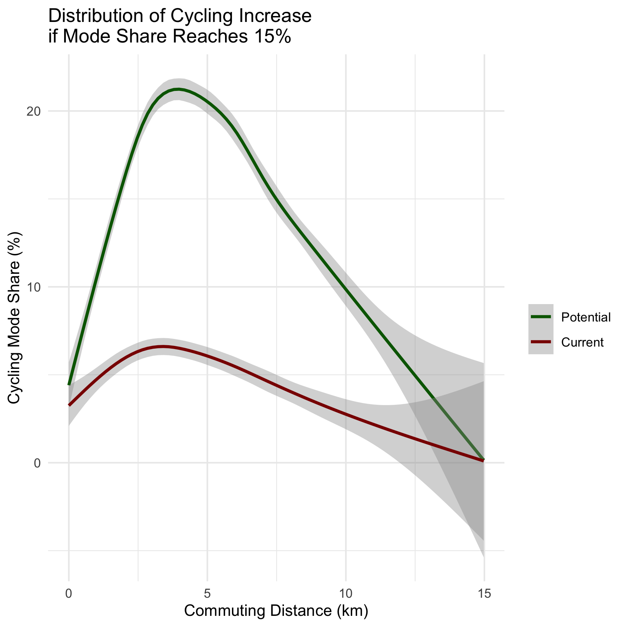

Slide 12
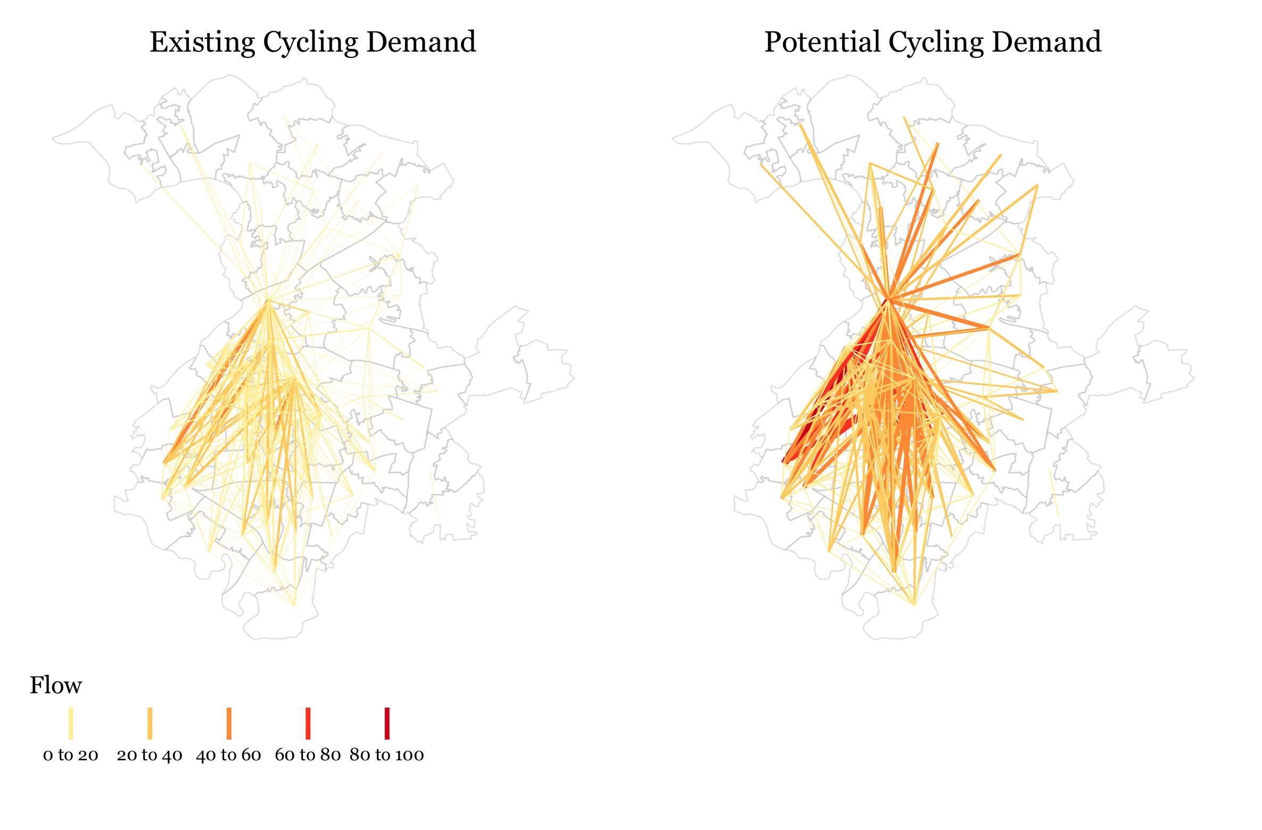

Slide 13
How Do We Route The Flows?

Slide 14
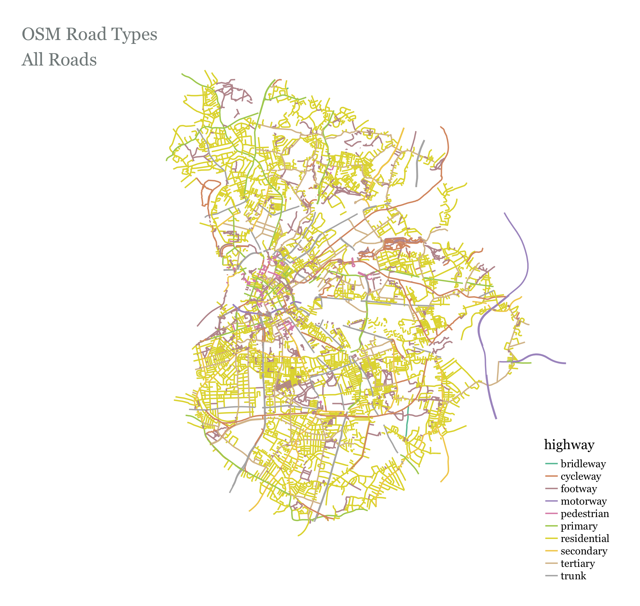

Slide 15
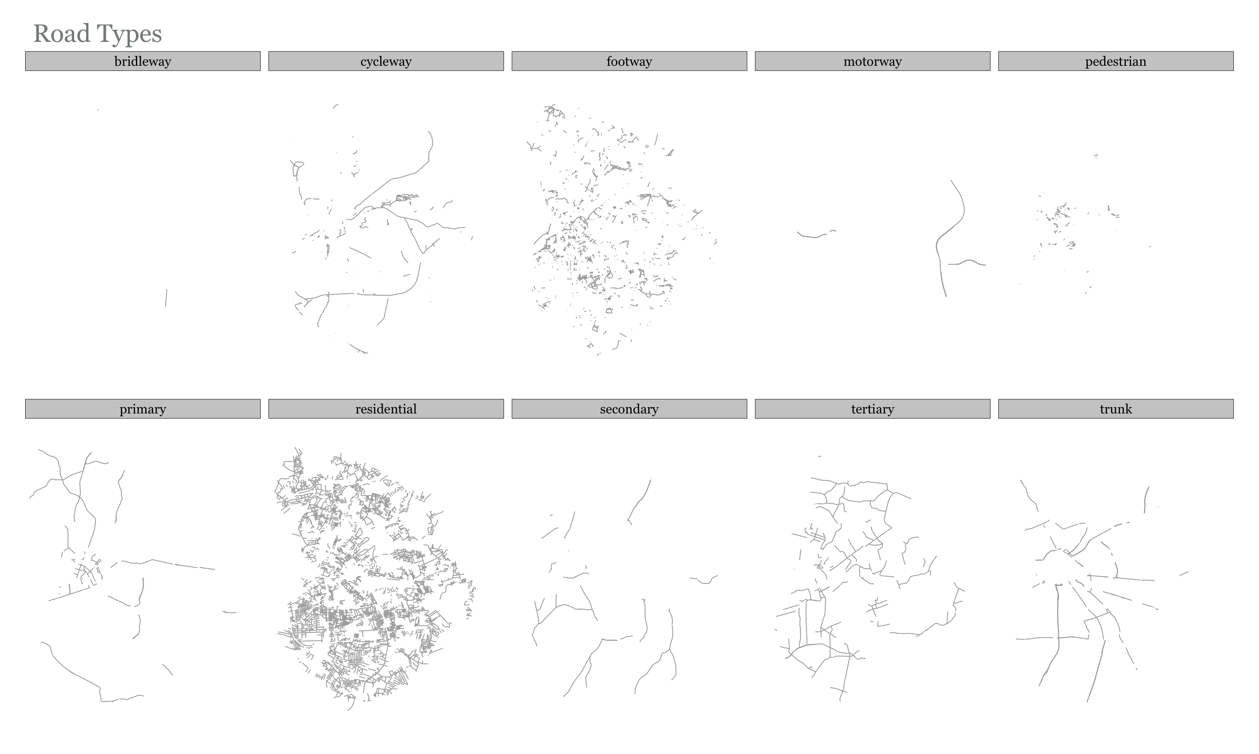

Slide 16
Routing Flows – Weighting Profiles the value is the % of commuters/flow that will choose that road type
Highway Type | 1. Default (from routino) | 2. Reduced Impedence on Trunk Roads | 3. Unweighted Shortest Paths (All roads equal)
motorway | 0 | ‘’ ‘’ ‘’ | 1
trunk | 0.3 | 0.7 | 1
primary | 0.7 | ‘’ ‘’ ‘’ | 1
secondary | 0.8 | ‘’ ‘’ ‘’ | 1
tertiary | 0.9 | ‘’ ‘’ ‘’ | 1
unclassified | 0.9 | ‘’ ‘’ ‘’ | 1
residential | 0.9 | ‘’ ‘’ ‘’ | 1
service | 0.9 | ‘’ ‘’ ‘’ | 1
track | 0.9 | ‘’ ‘’ ‘’ | 1
cycleway | 1 | ‘’ ‘’ ‘’ | 1
path | 0.9 | ‘’ ‘’ ‘’ | 1
steps | 0 | ‘’ ‘’ ‘’ | 1
ferry | 0.2 | ‘’ ‘’ ‘’ | 1

Slide 17
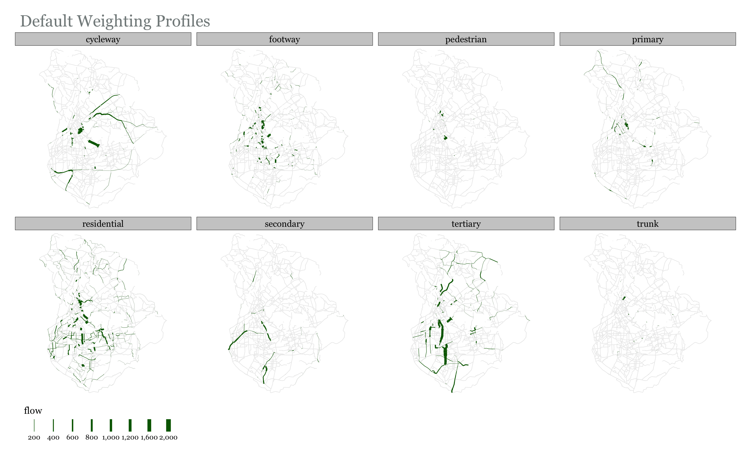

Slide 18
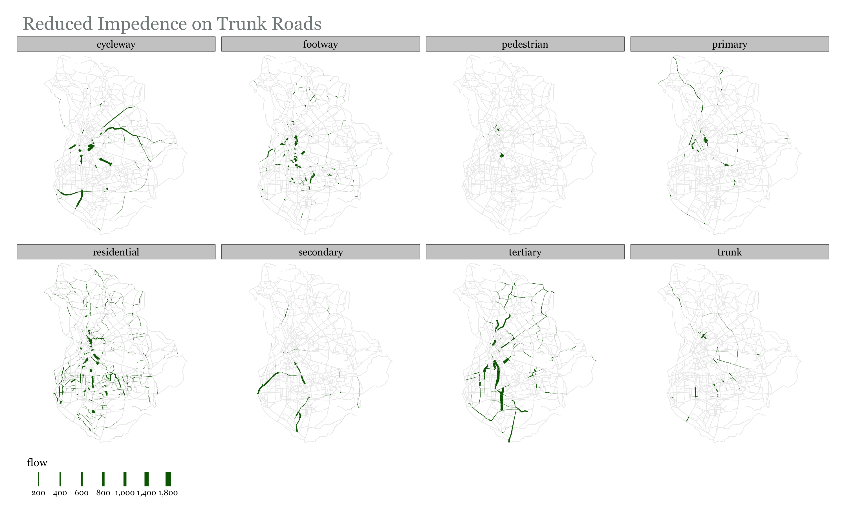

Slide 19
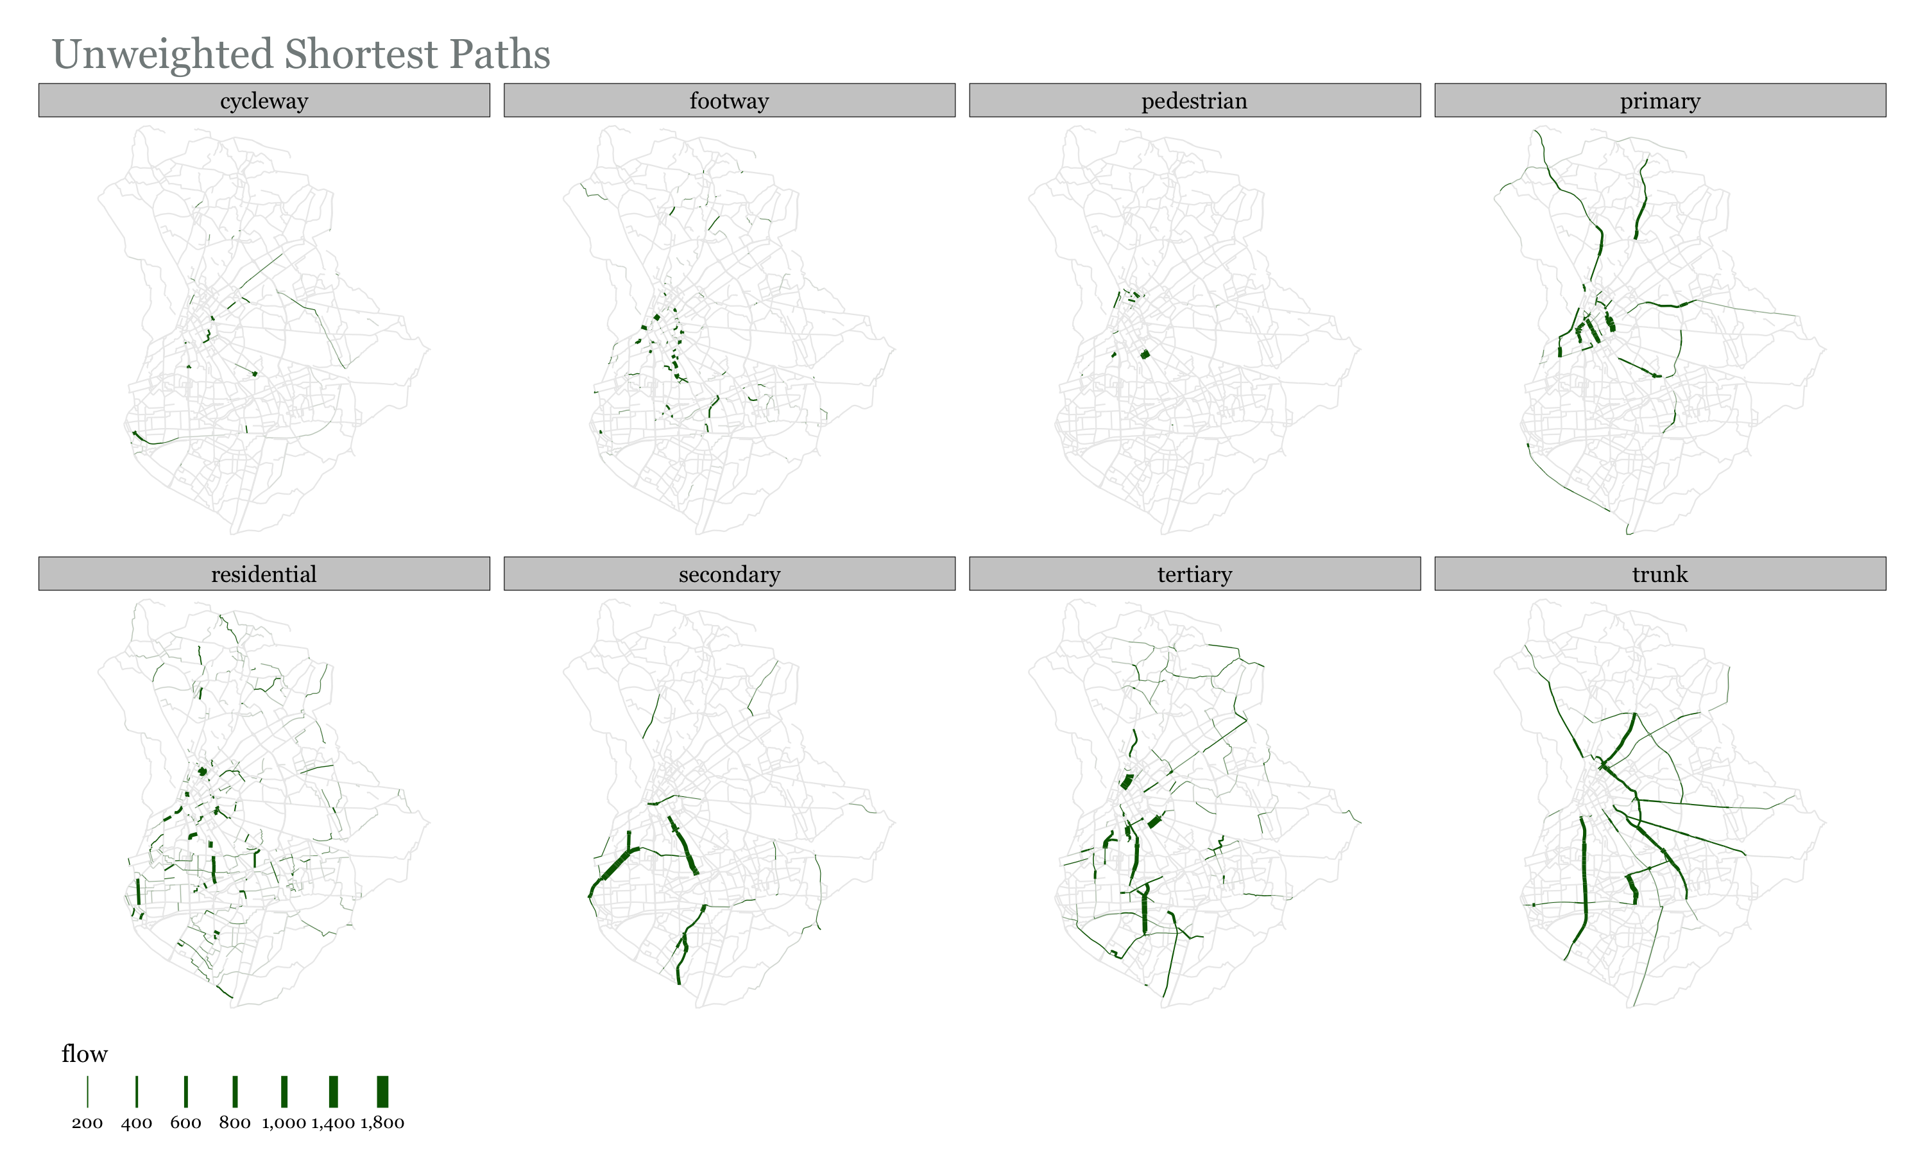

Slide 20
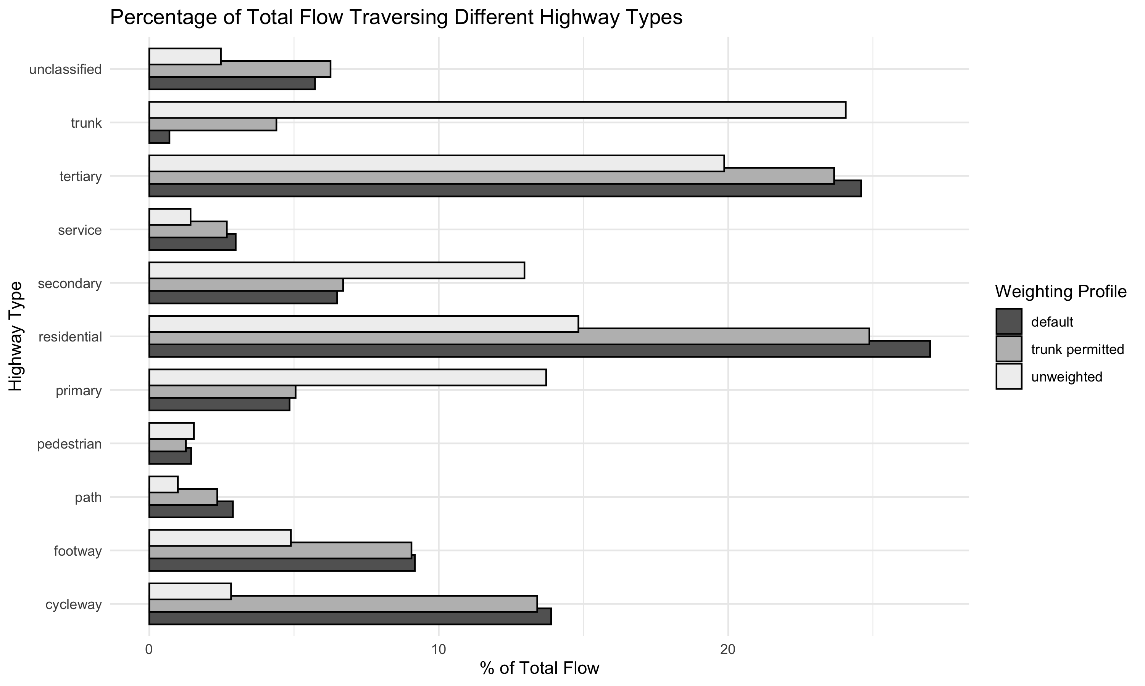

Slide 21
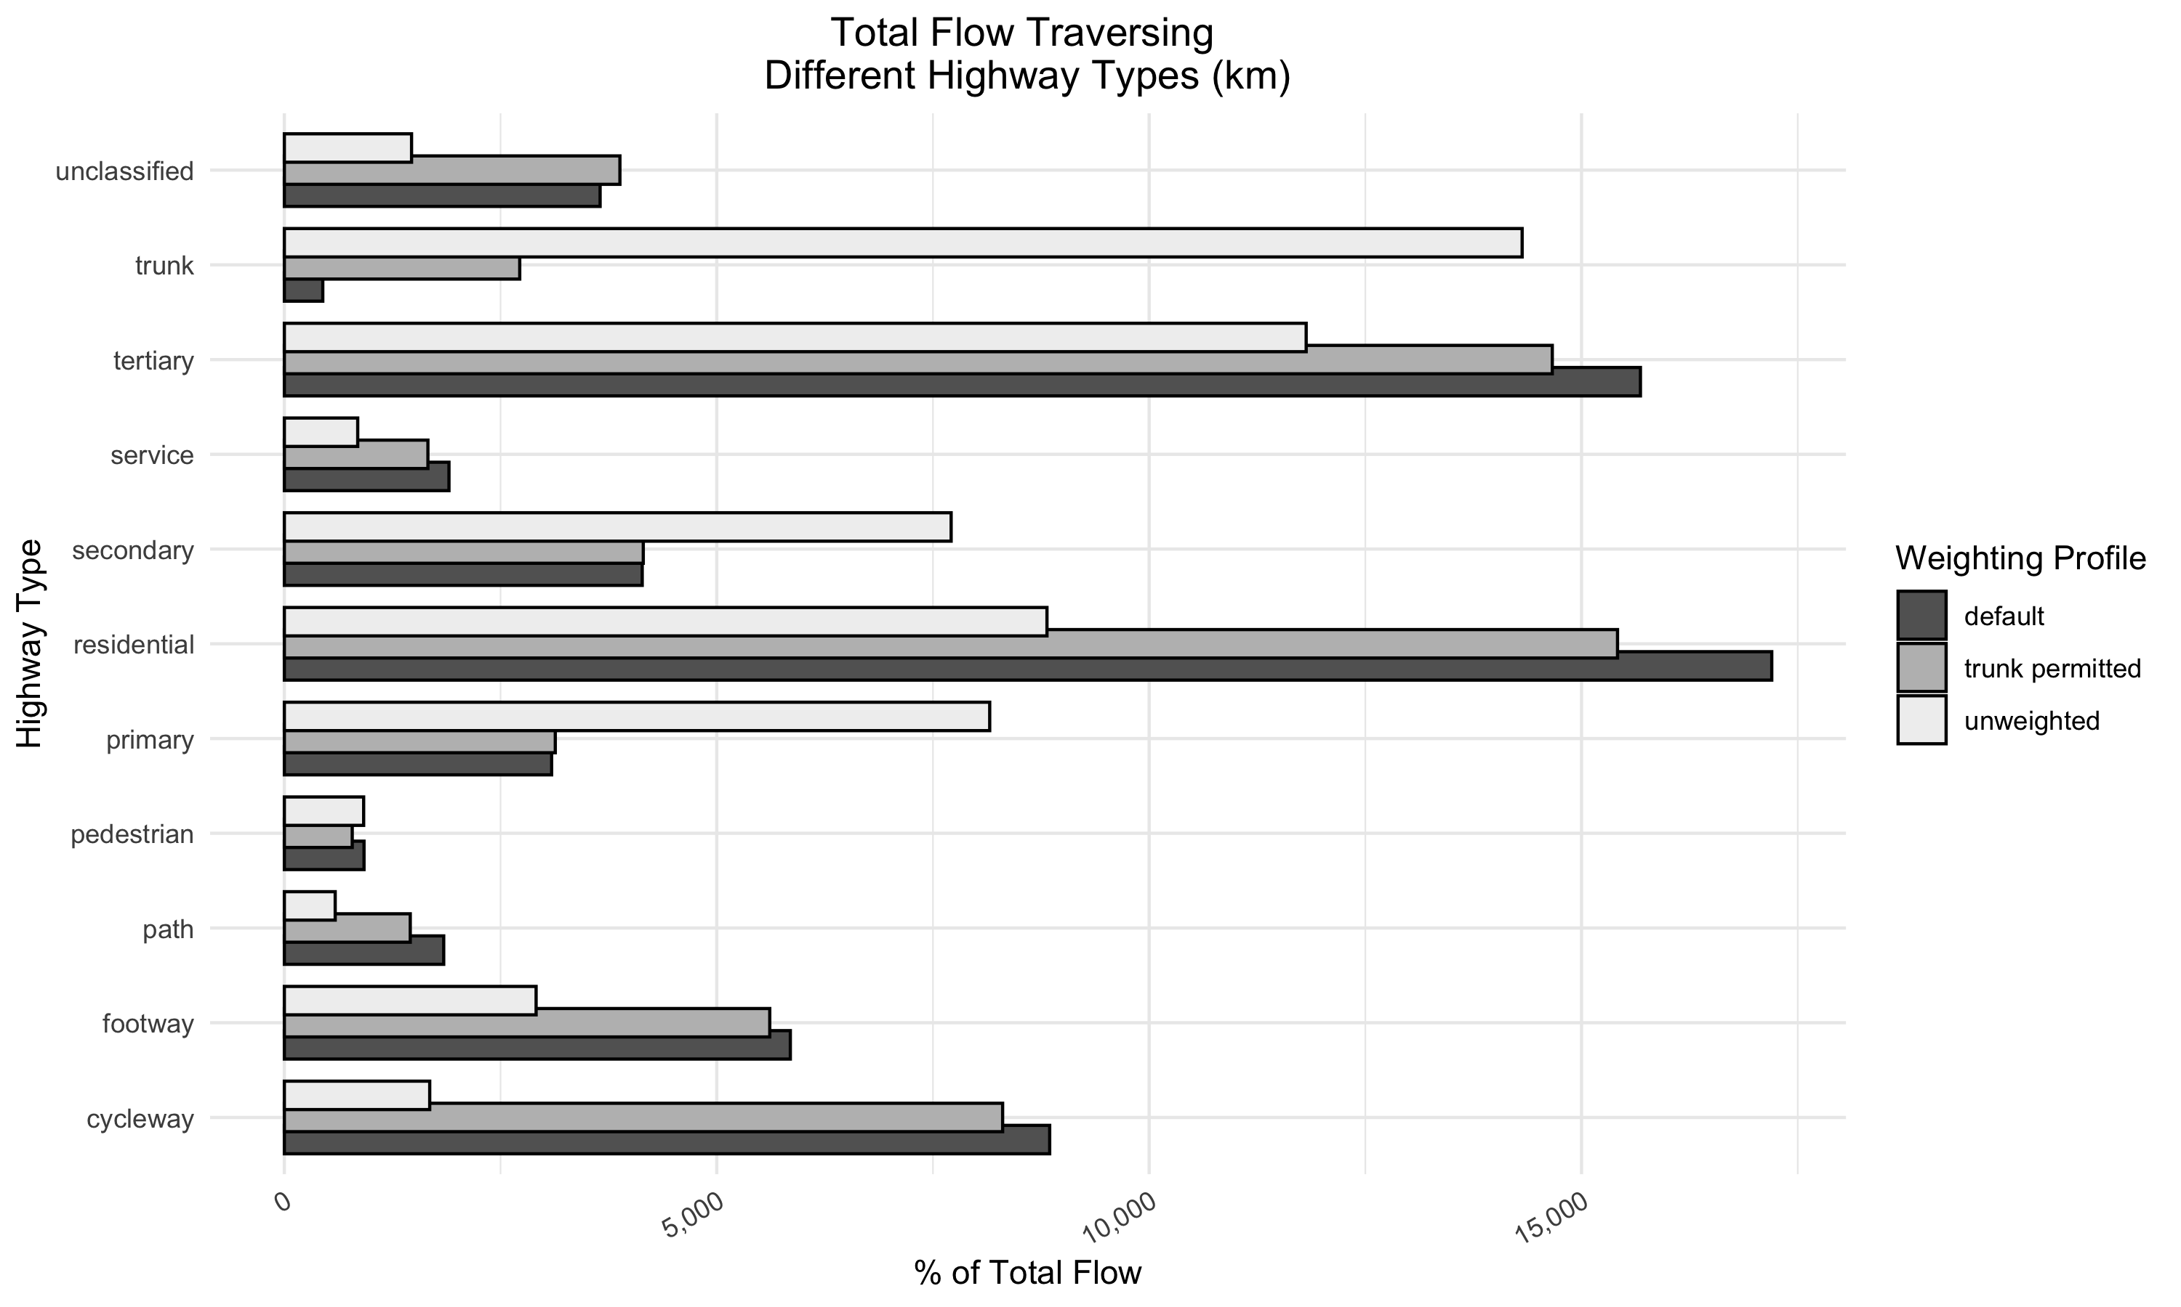

Slide 22
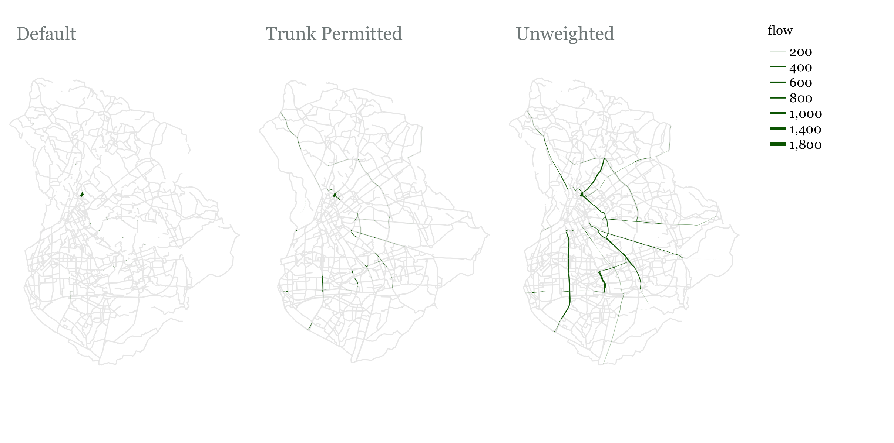
Flow on Trunk Roads

Slide 23
Notes
Trunk roads are direct so they are part of unweighted shortest paths
Can cycling infrastructure be added to all of them? Is there enough funding? Is it technically possible?
If the answer to any of the above is no, then we should use a weighted road network for routing

Slide 24
How Do Prioritize Road Segments?
Things to Consider
- Connectedness
- Fair Distribution of investment

Slide 25
Fair Distribution – Community Detection
If we identify the different communities that exist in the city, we can see the effect of any growth algorithm on each community
Here we identify communities based on the potential cycling flow between them

Slide 26
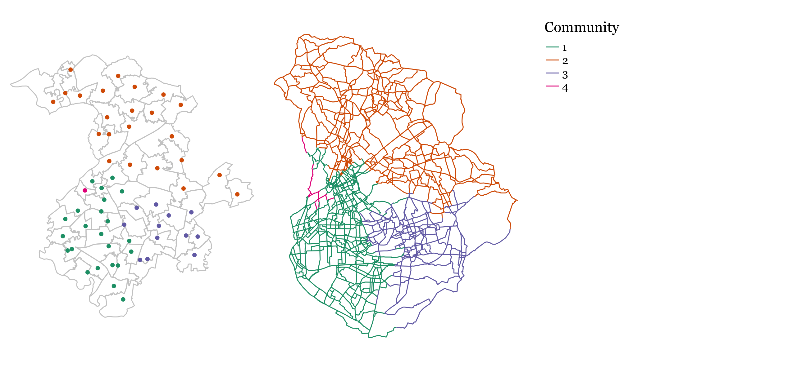
Communities – Louvain Algorithm
MSOAs assigned to communities based on potential flow between them
Edges assigned to communities based on their proximity to MSOA centroids

Slide 27
Function 1 – One Seed
We aim for a connected network. We grow the network incrementally by selecting neighboring edges.
How to prioritize edges?
Option1: Flow passing through them: Higher is better
Option 2: Person_km Satisfied: Edges have different lengths so ‘person_km satisfied’ accounts for that. It is equal to: Flow on edge * length of edge

Slide 28
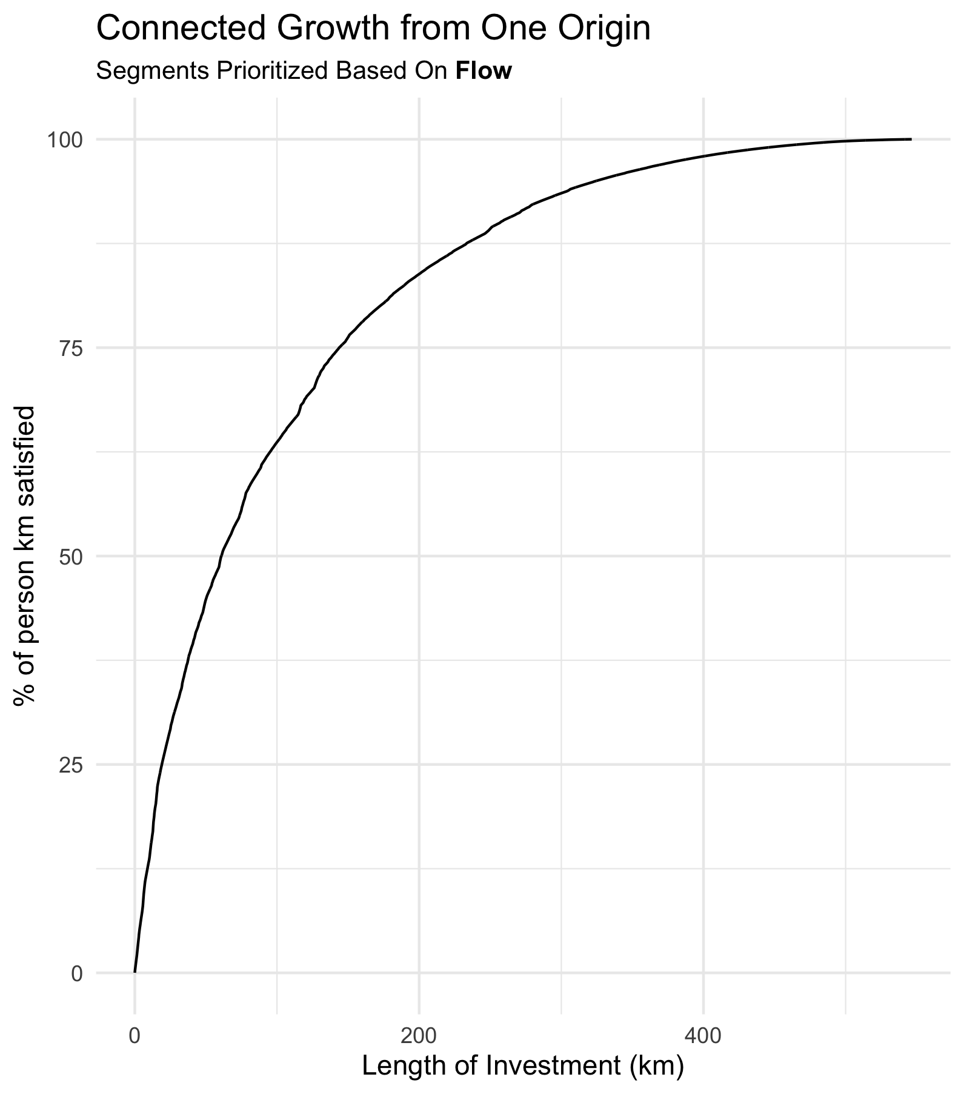
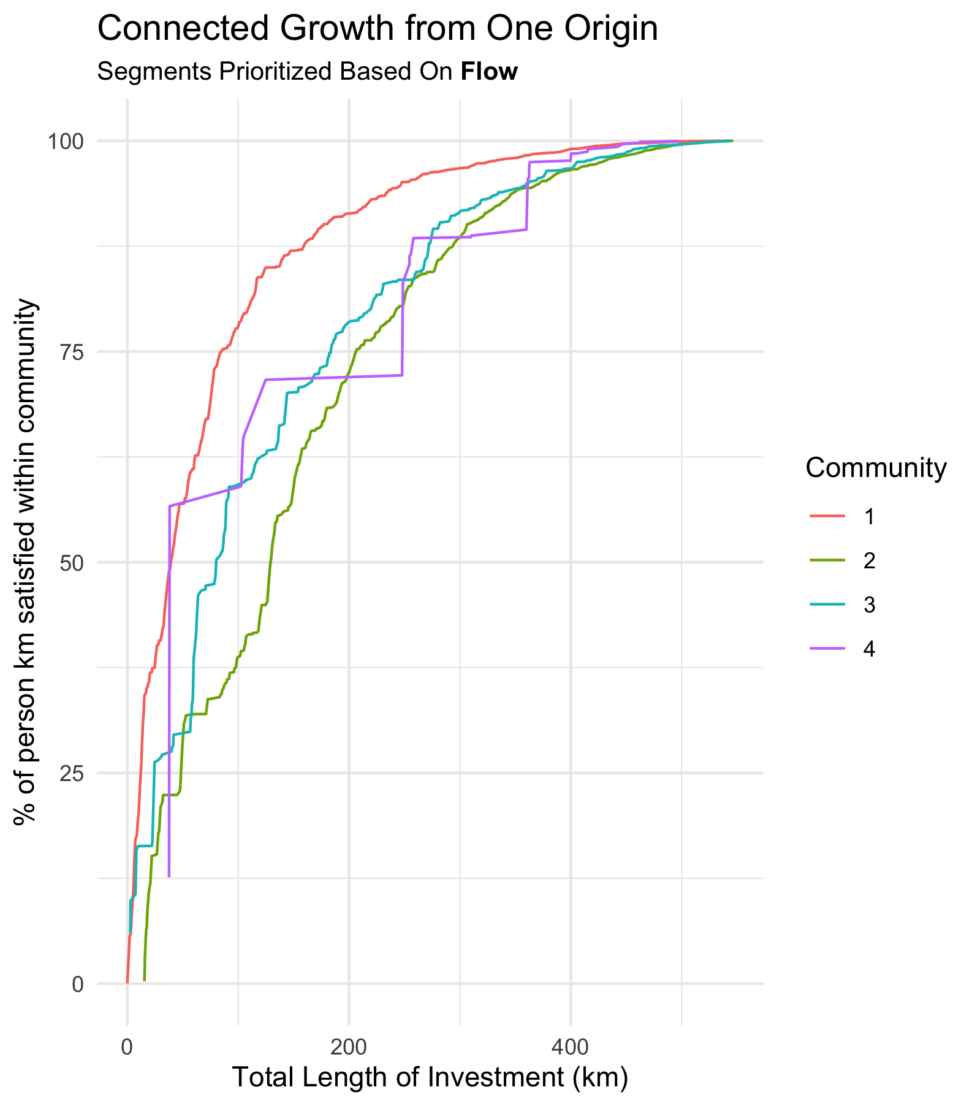

Slide 29
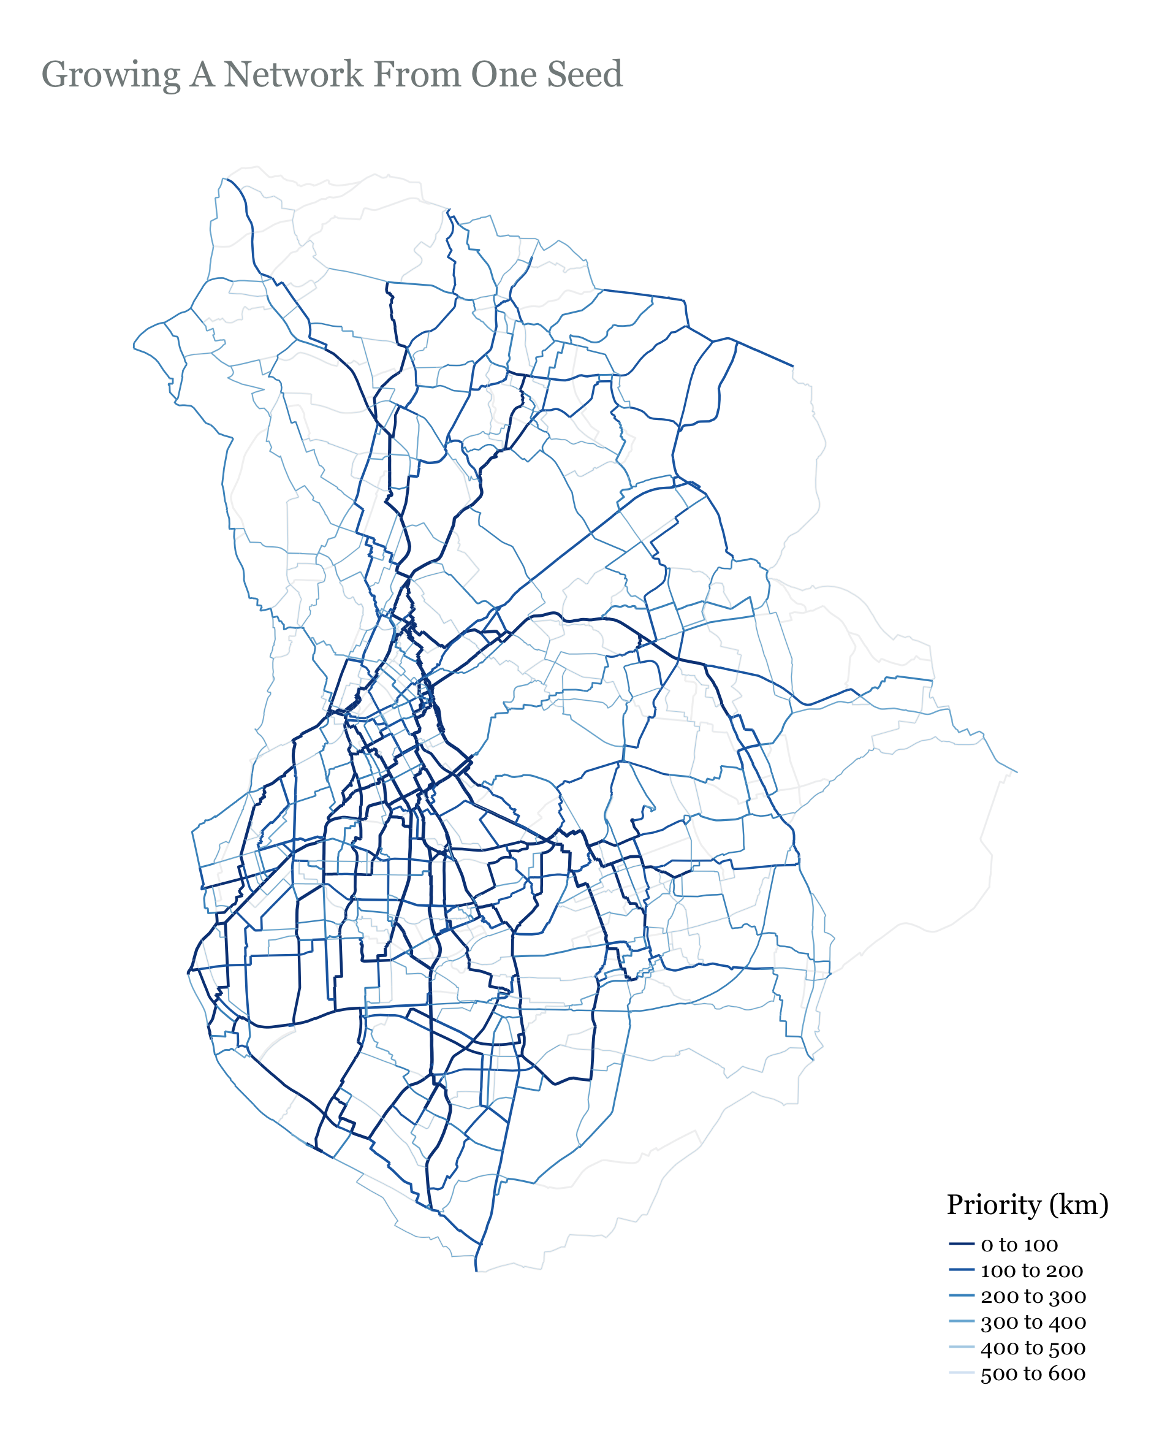

Slide 30
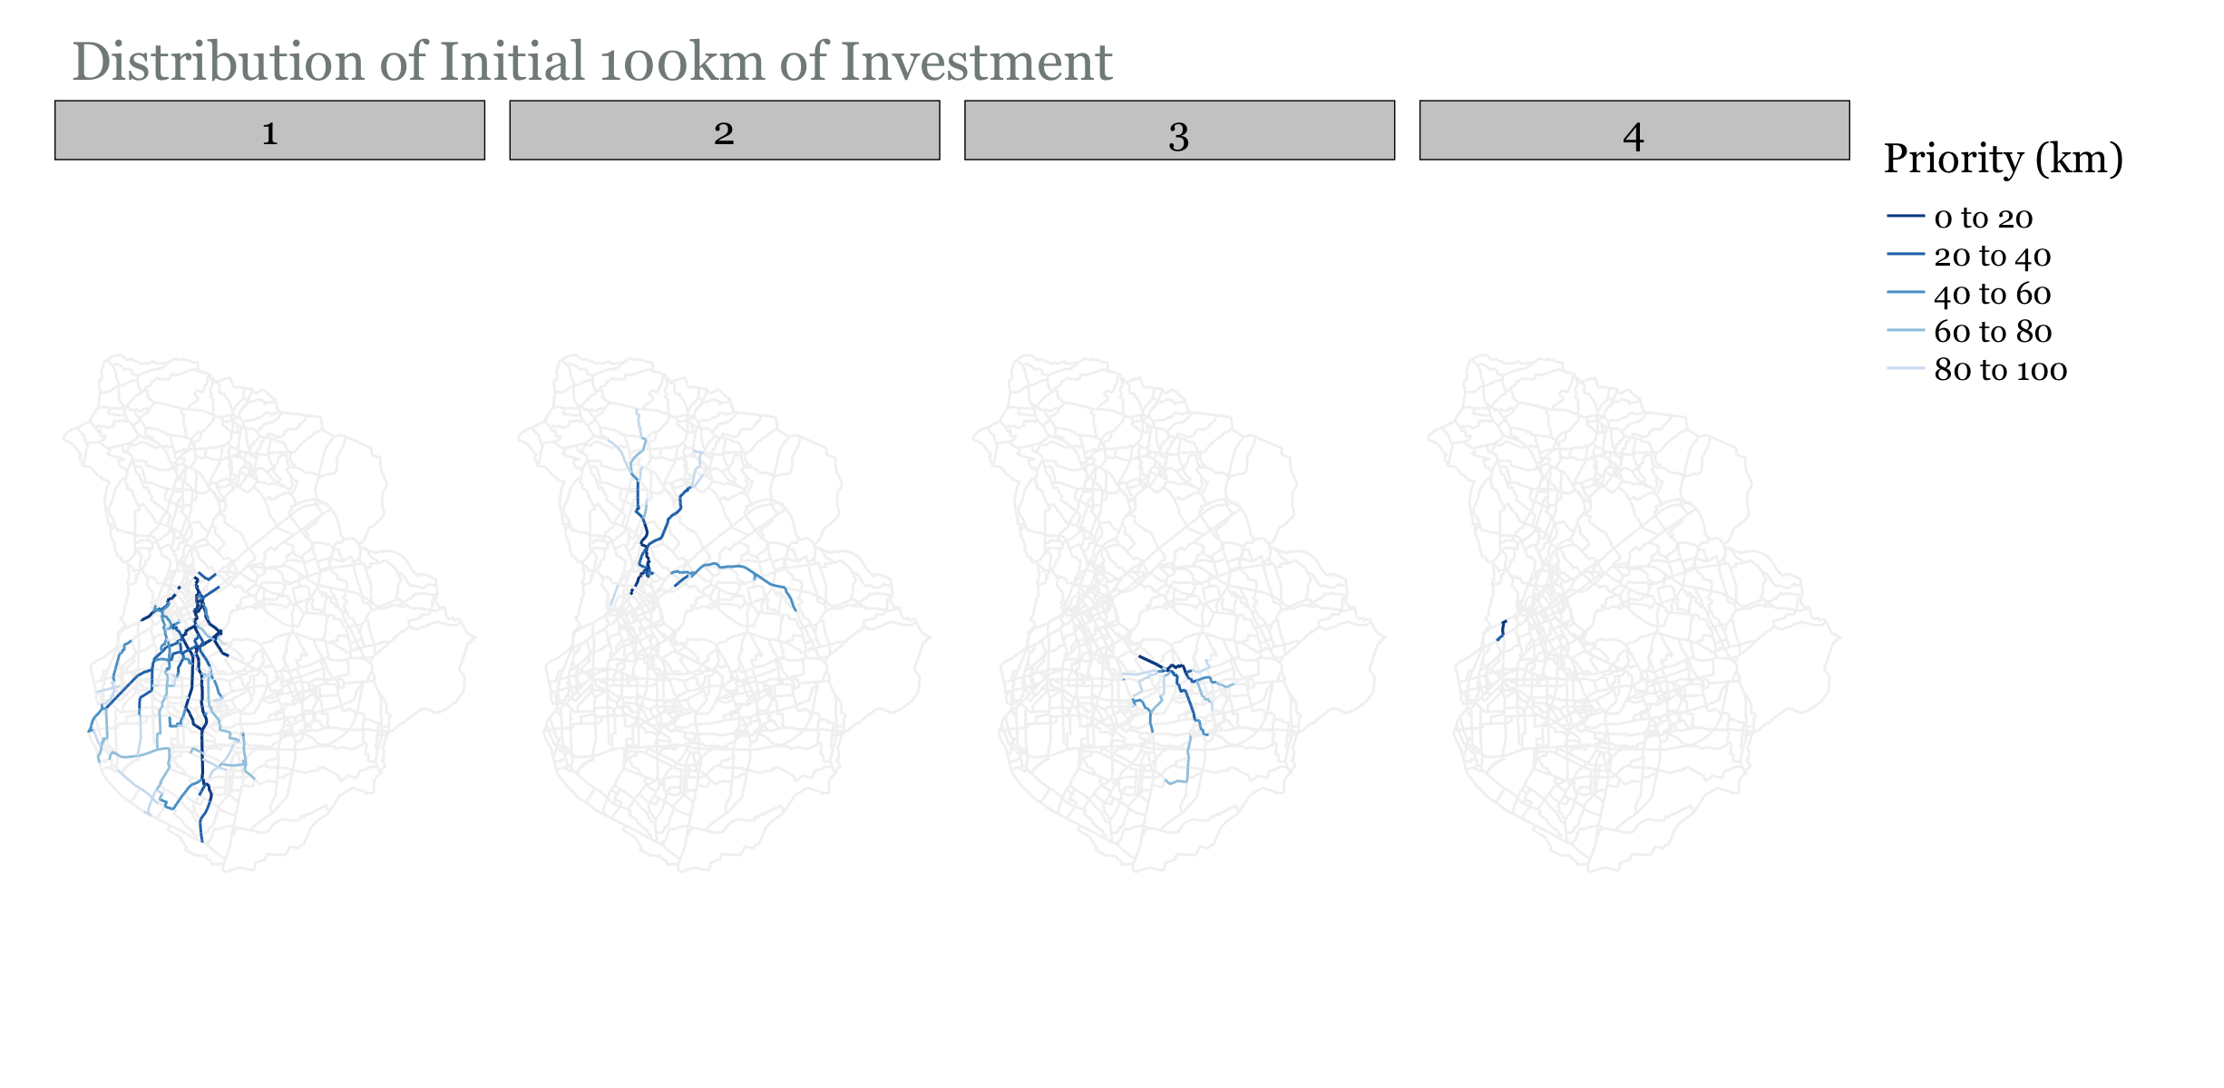
Growth is predominantly in Community 1…

Slide 31
Notes
Does not account for existing infrastructure
Does not ensure equal distribution of investment

Slide 32
Function 2 – Growth from Existing Infrastructure
1. select investment length (km)
2. Identify all edges with cycling infrastructure
3. Add these edges to solution
4. Identify all edges that are connected to the current solution
5. Select edge with highest flow and append it to the solution
6. Repeat steps 4 & 5 until the length of the edges in the solution reaches the investment length

Slide 33
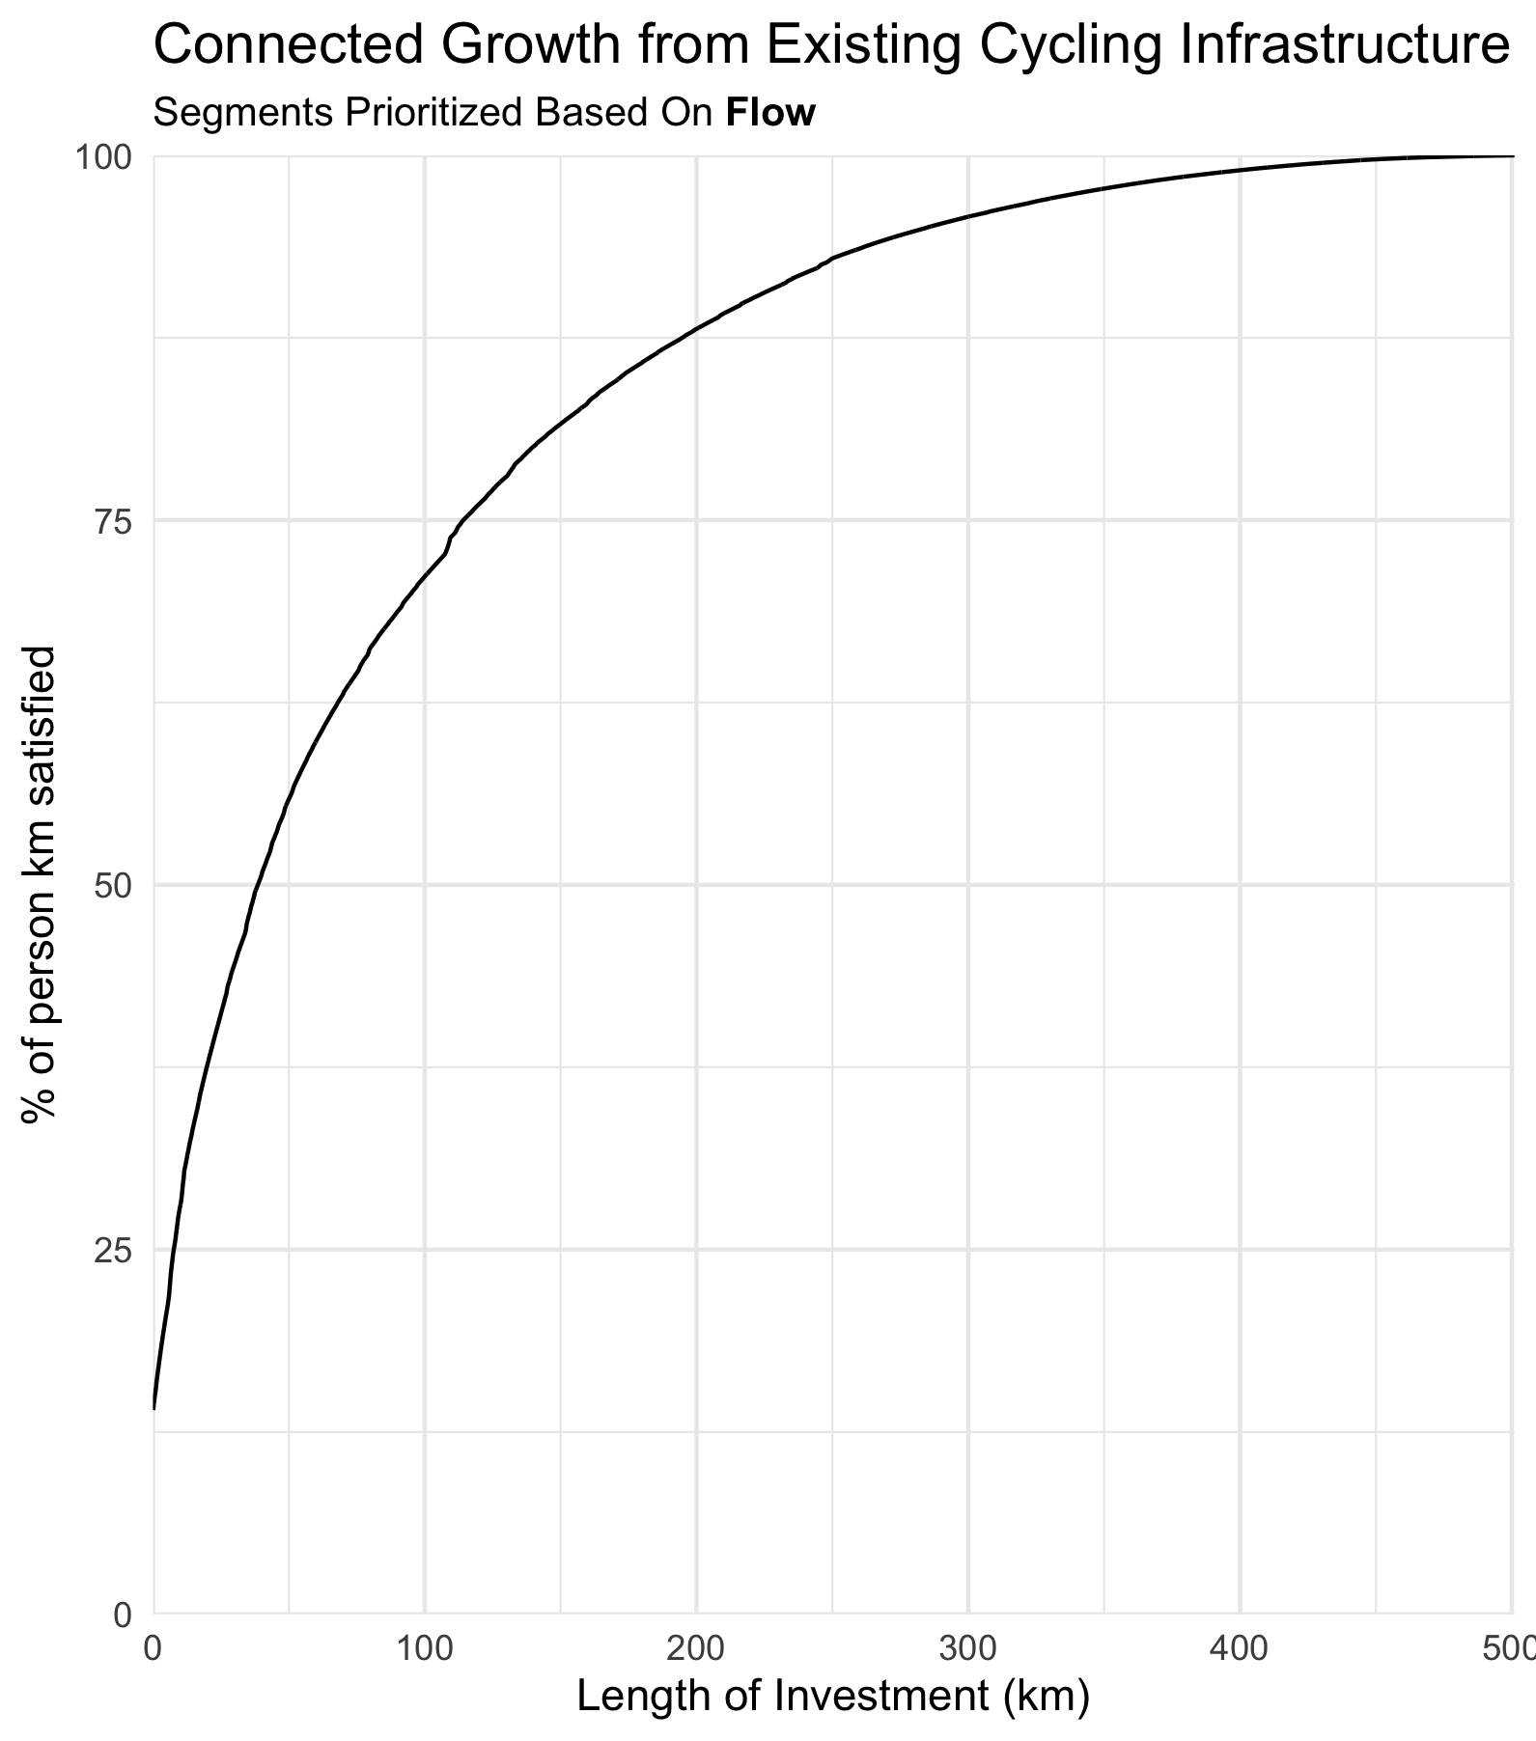
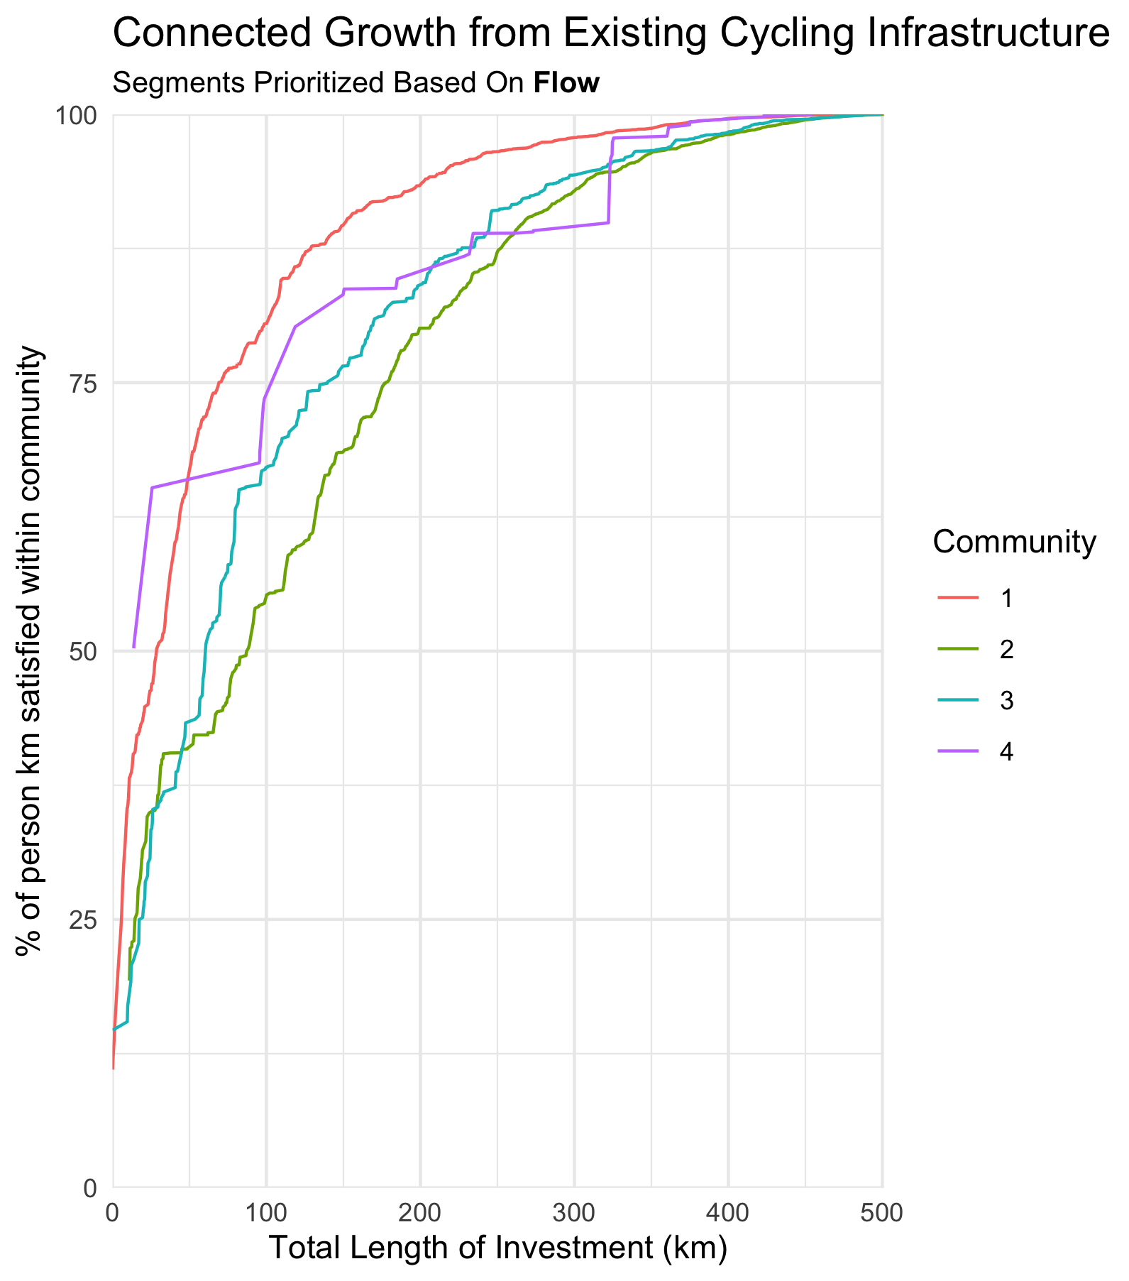
Connected Growth From Existing Infrastructure

Slide 34
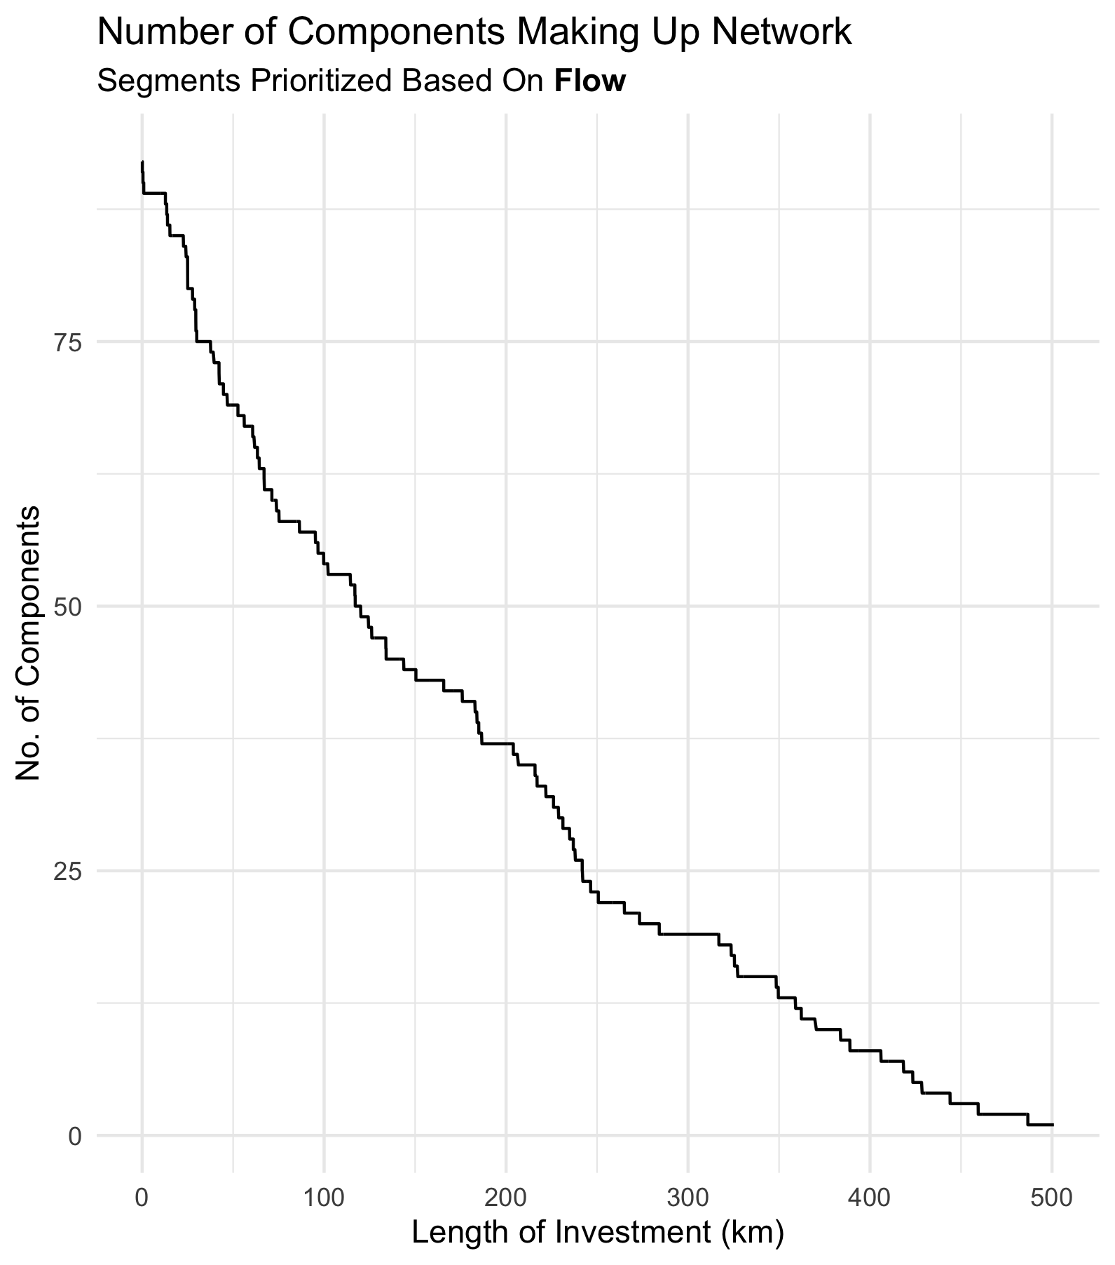
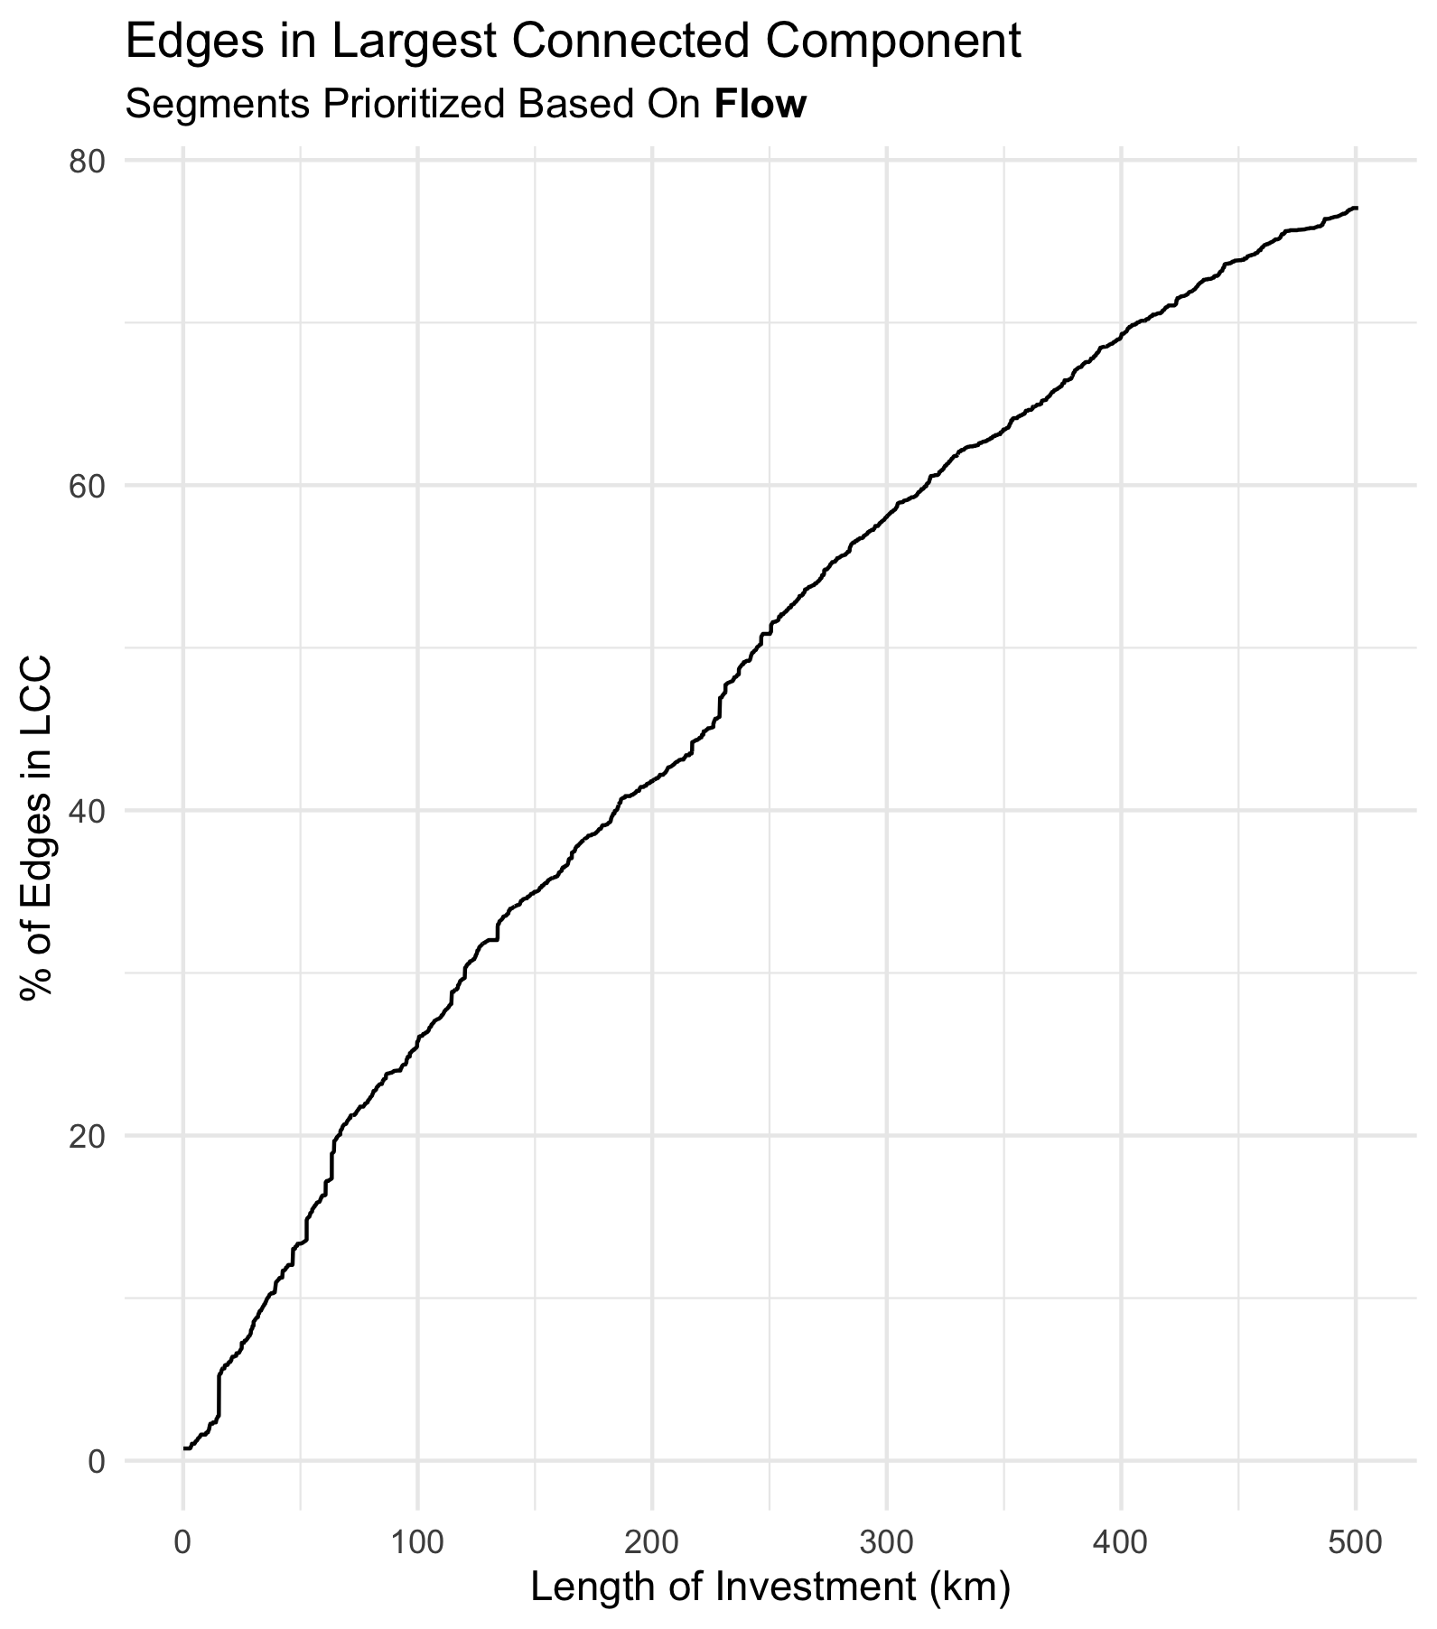

Slide 35
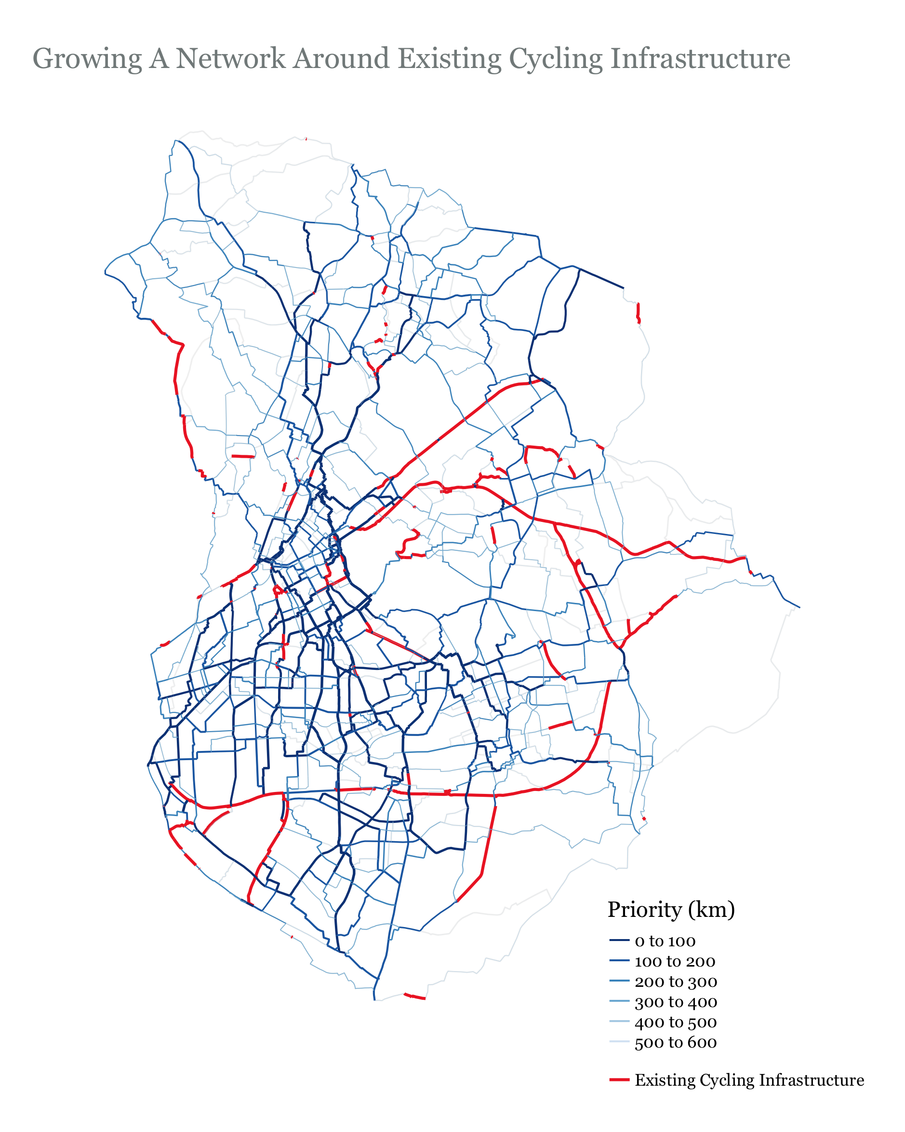

Slide 36
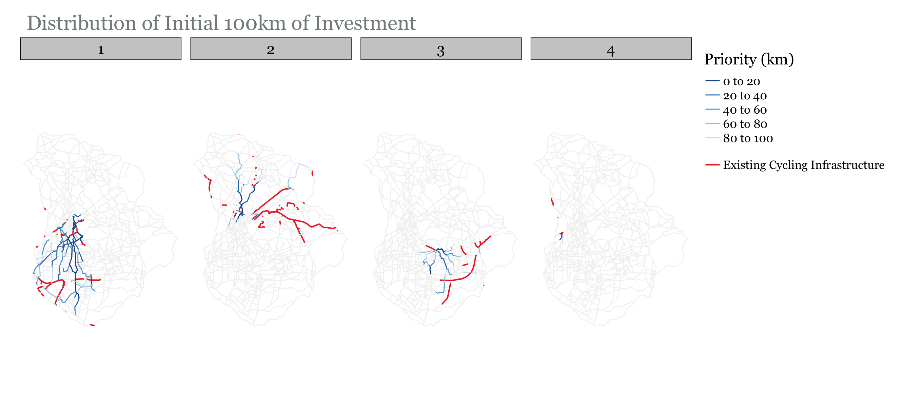
Growth still predominantly in Community 1…

Slide 37
Notes
Having Multiple Seeds allows for more spread out growth
We are still not explicity distributing investment equally/fairly

Slide 38
Function 3 – Growth Shared Between Communities
Select investment length (km)
Identify edge with highest flow in each community
Add these edges to solution
For edges in each community
identify all edges from that community that [a] have not yet been chosen AND [b] neighbor the edges in the current solution
Select edge from [i] with highest flow and append it to the solution
Keep looping over the communities and selecting edges until you reach the investment length
BUT SHOULD WE SELECT EDGES BASED ON FLOW OR PERSON KM SATISFIED?

Slide 39
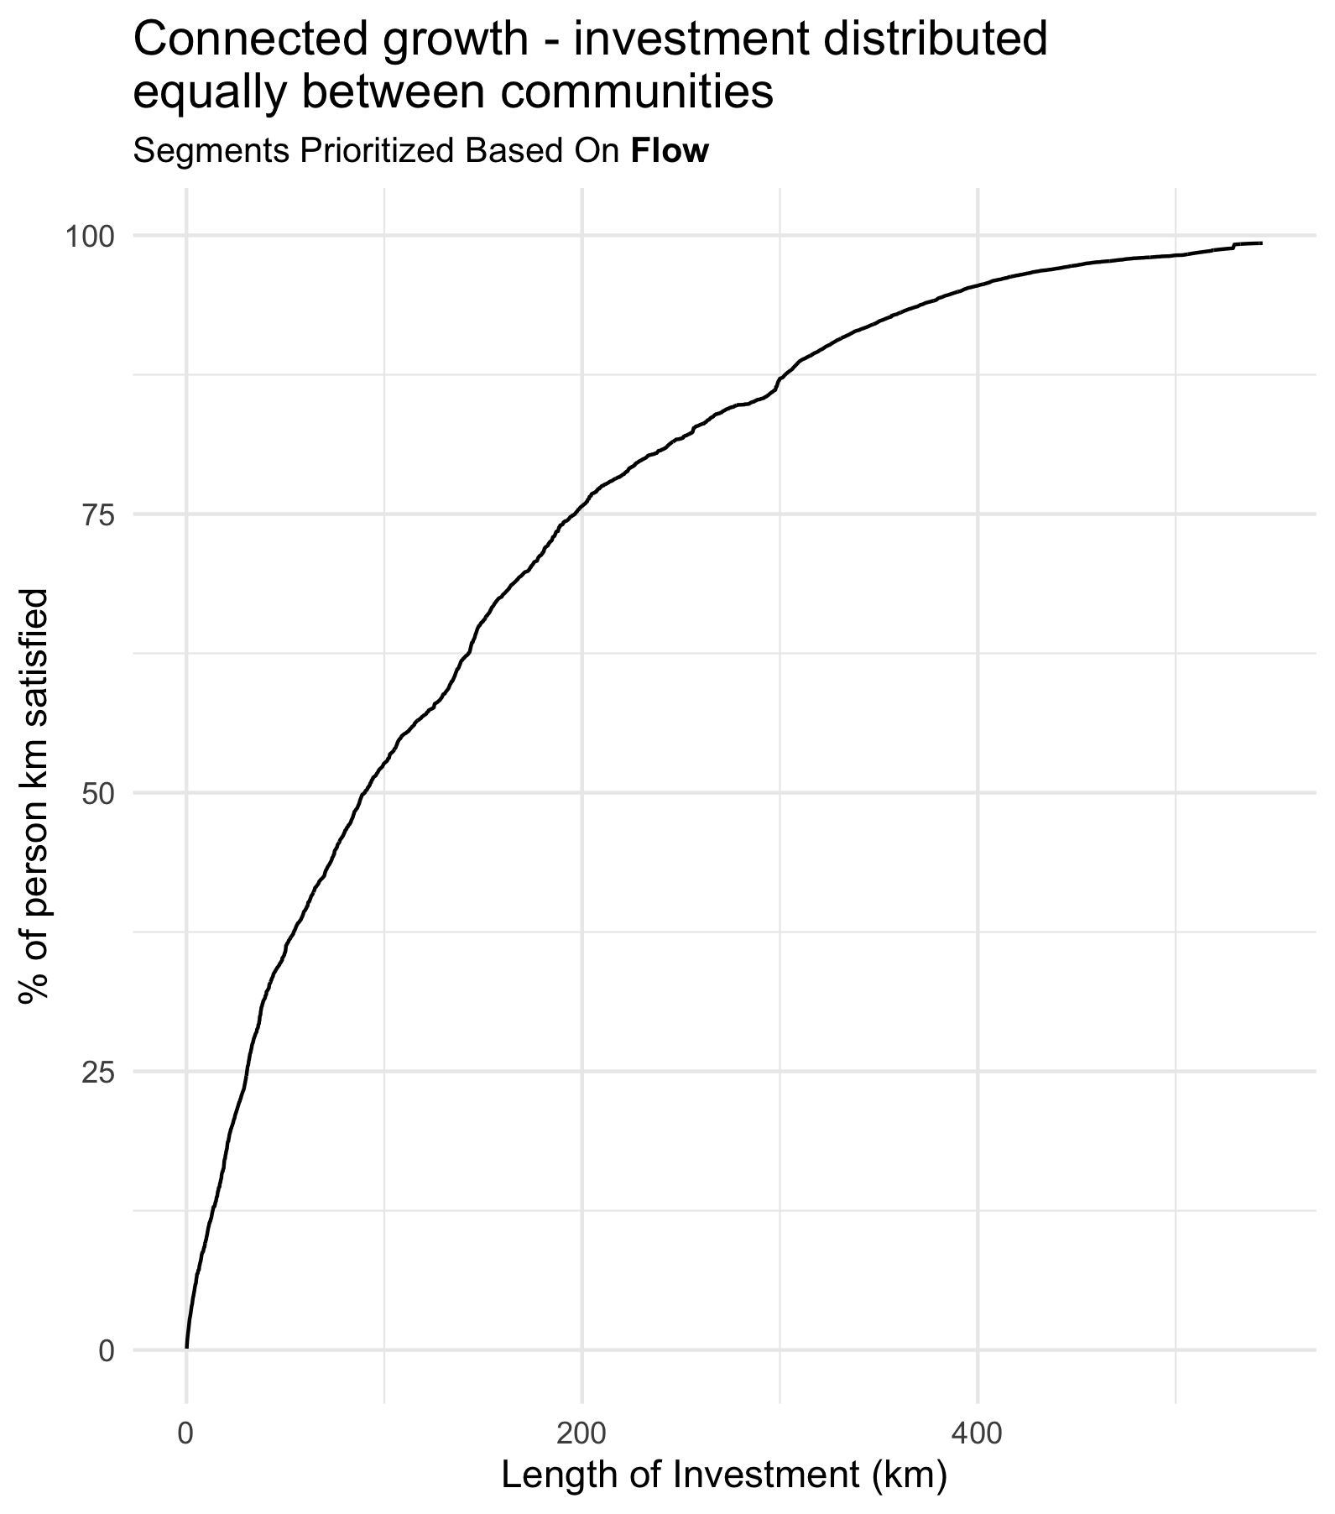
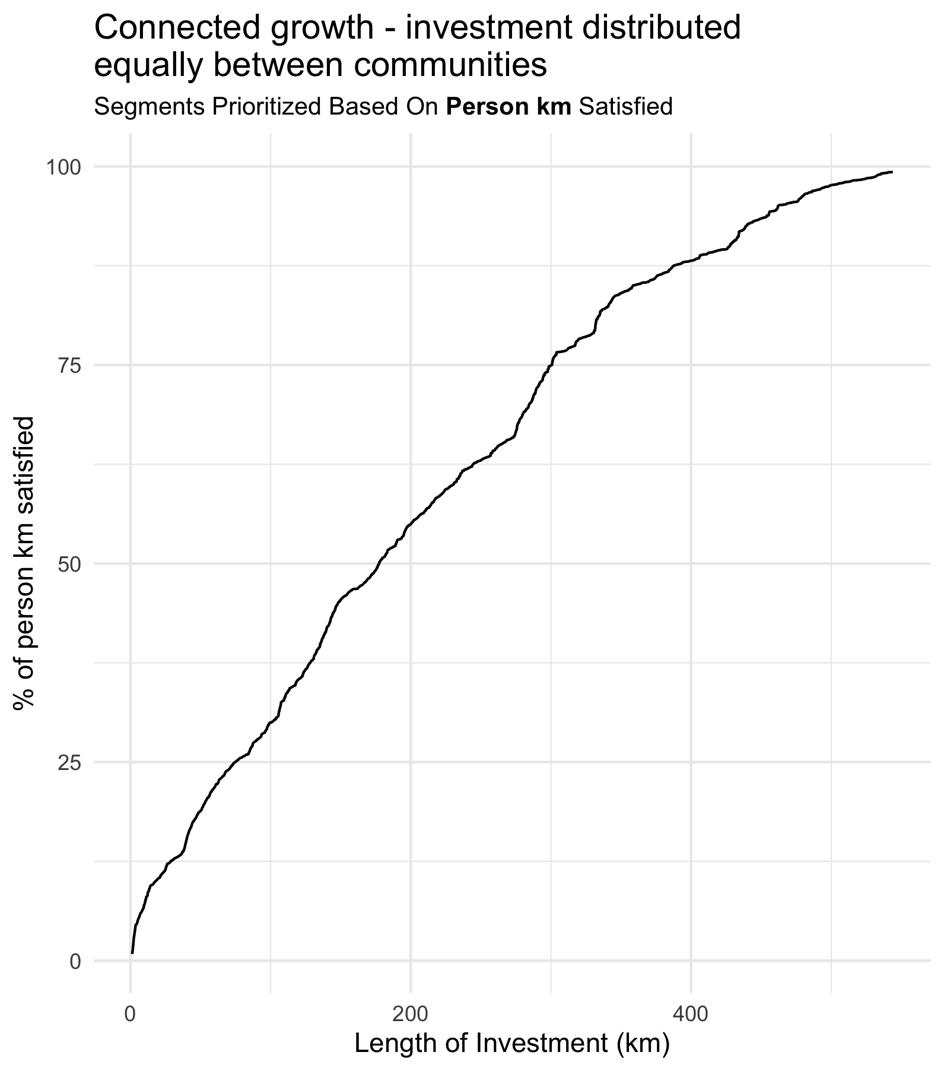

Slide 40
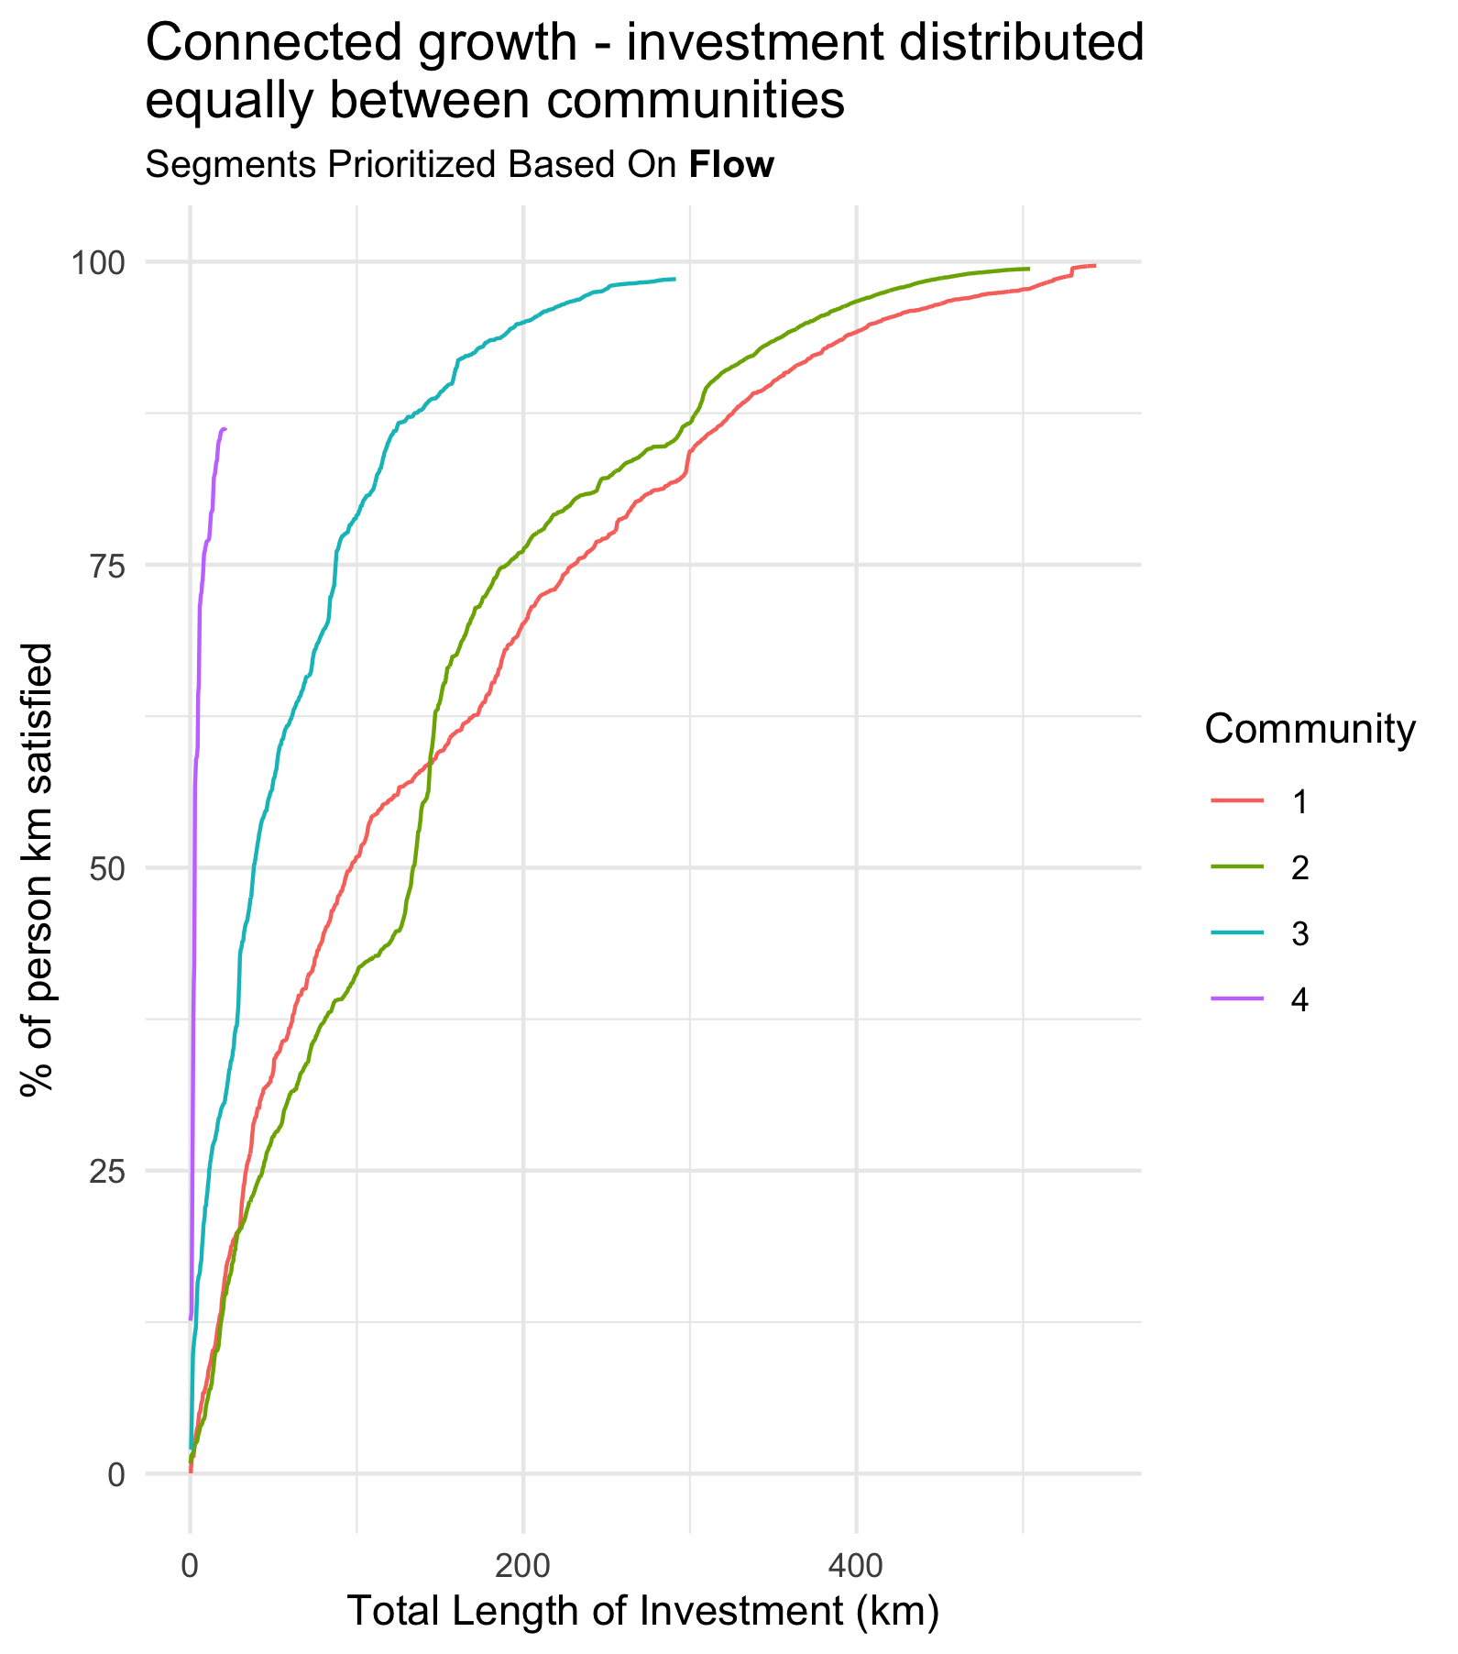
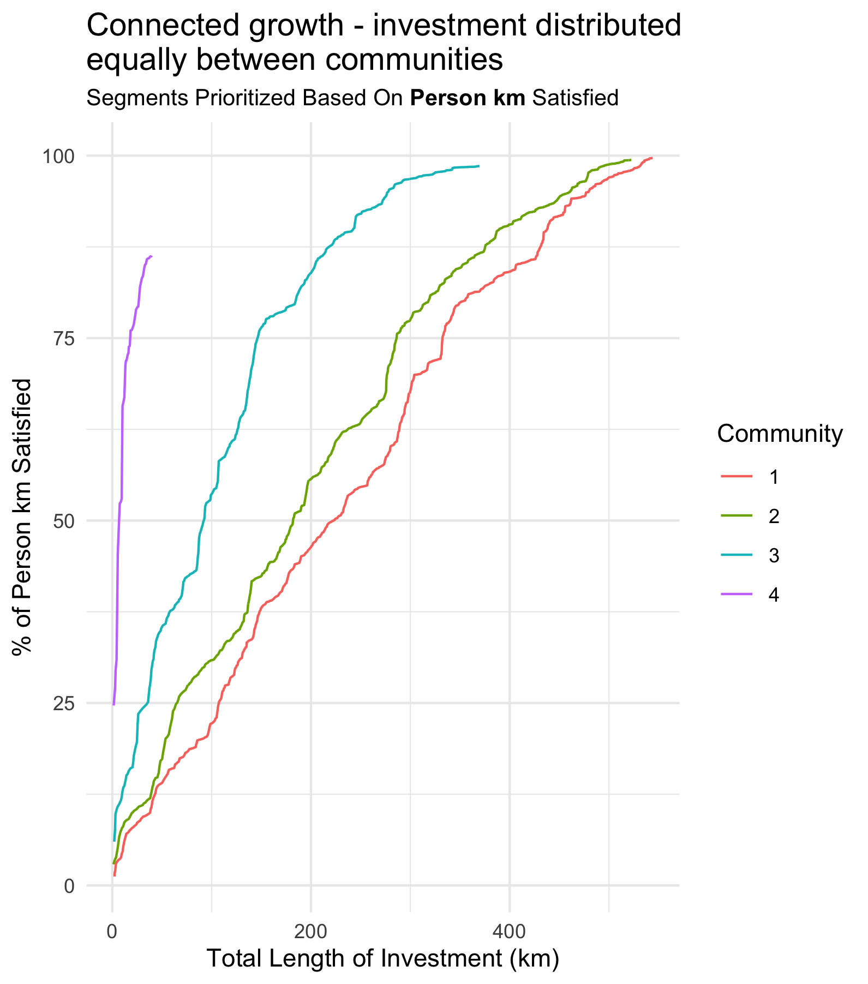

Slide 41
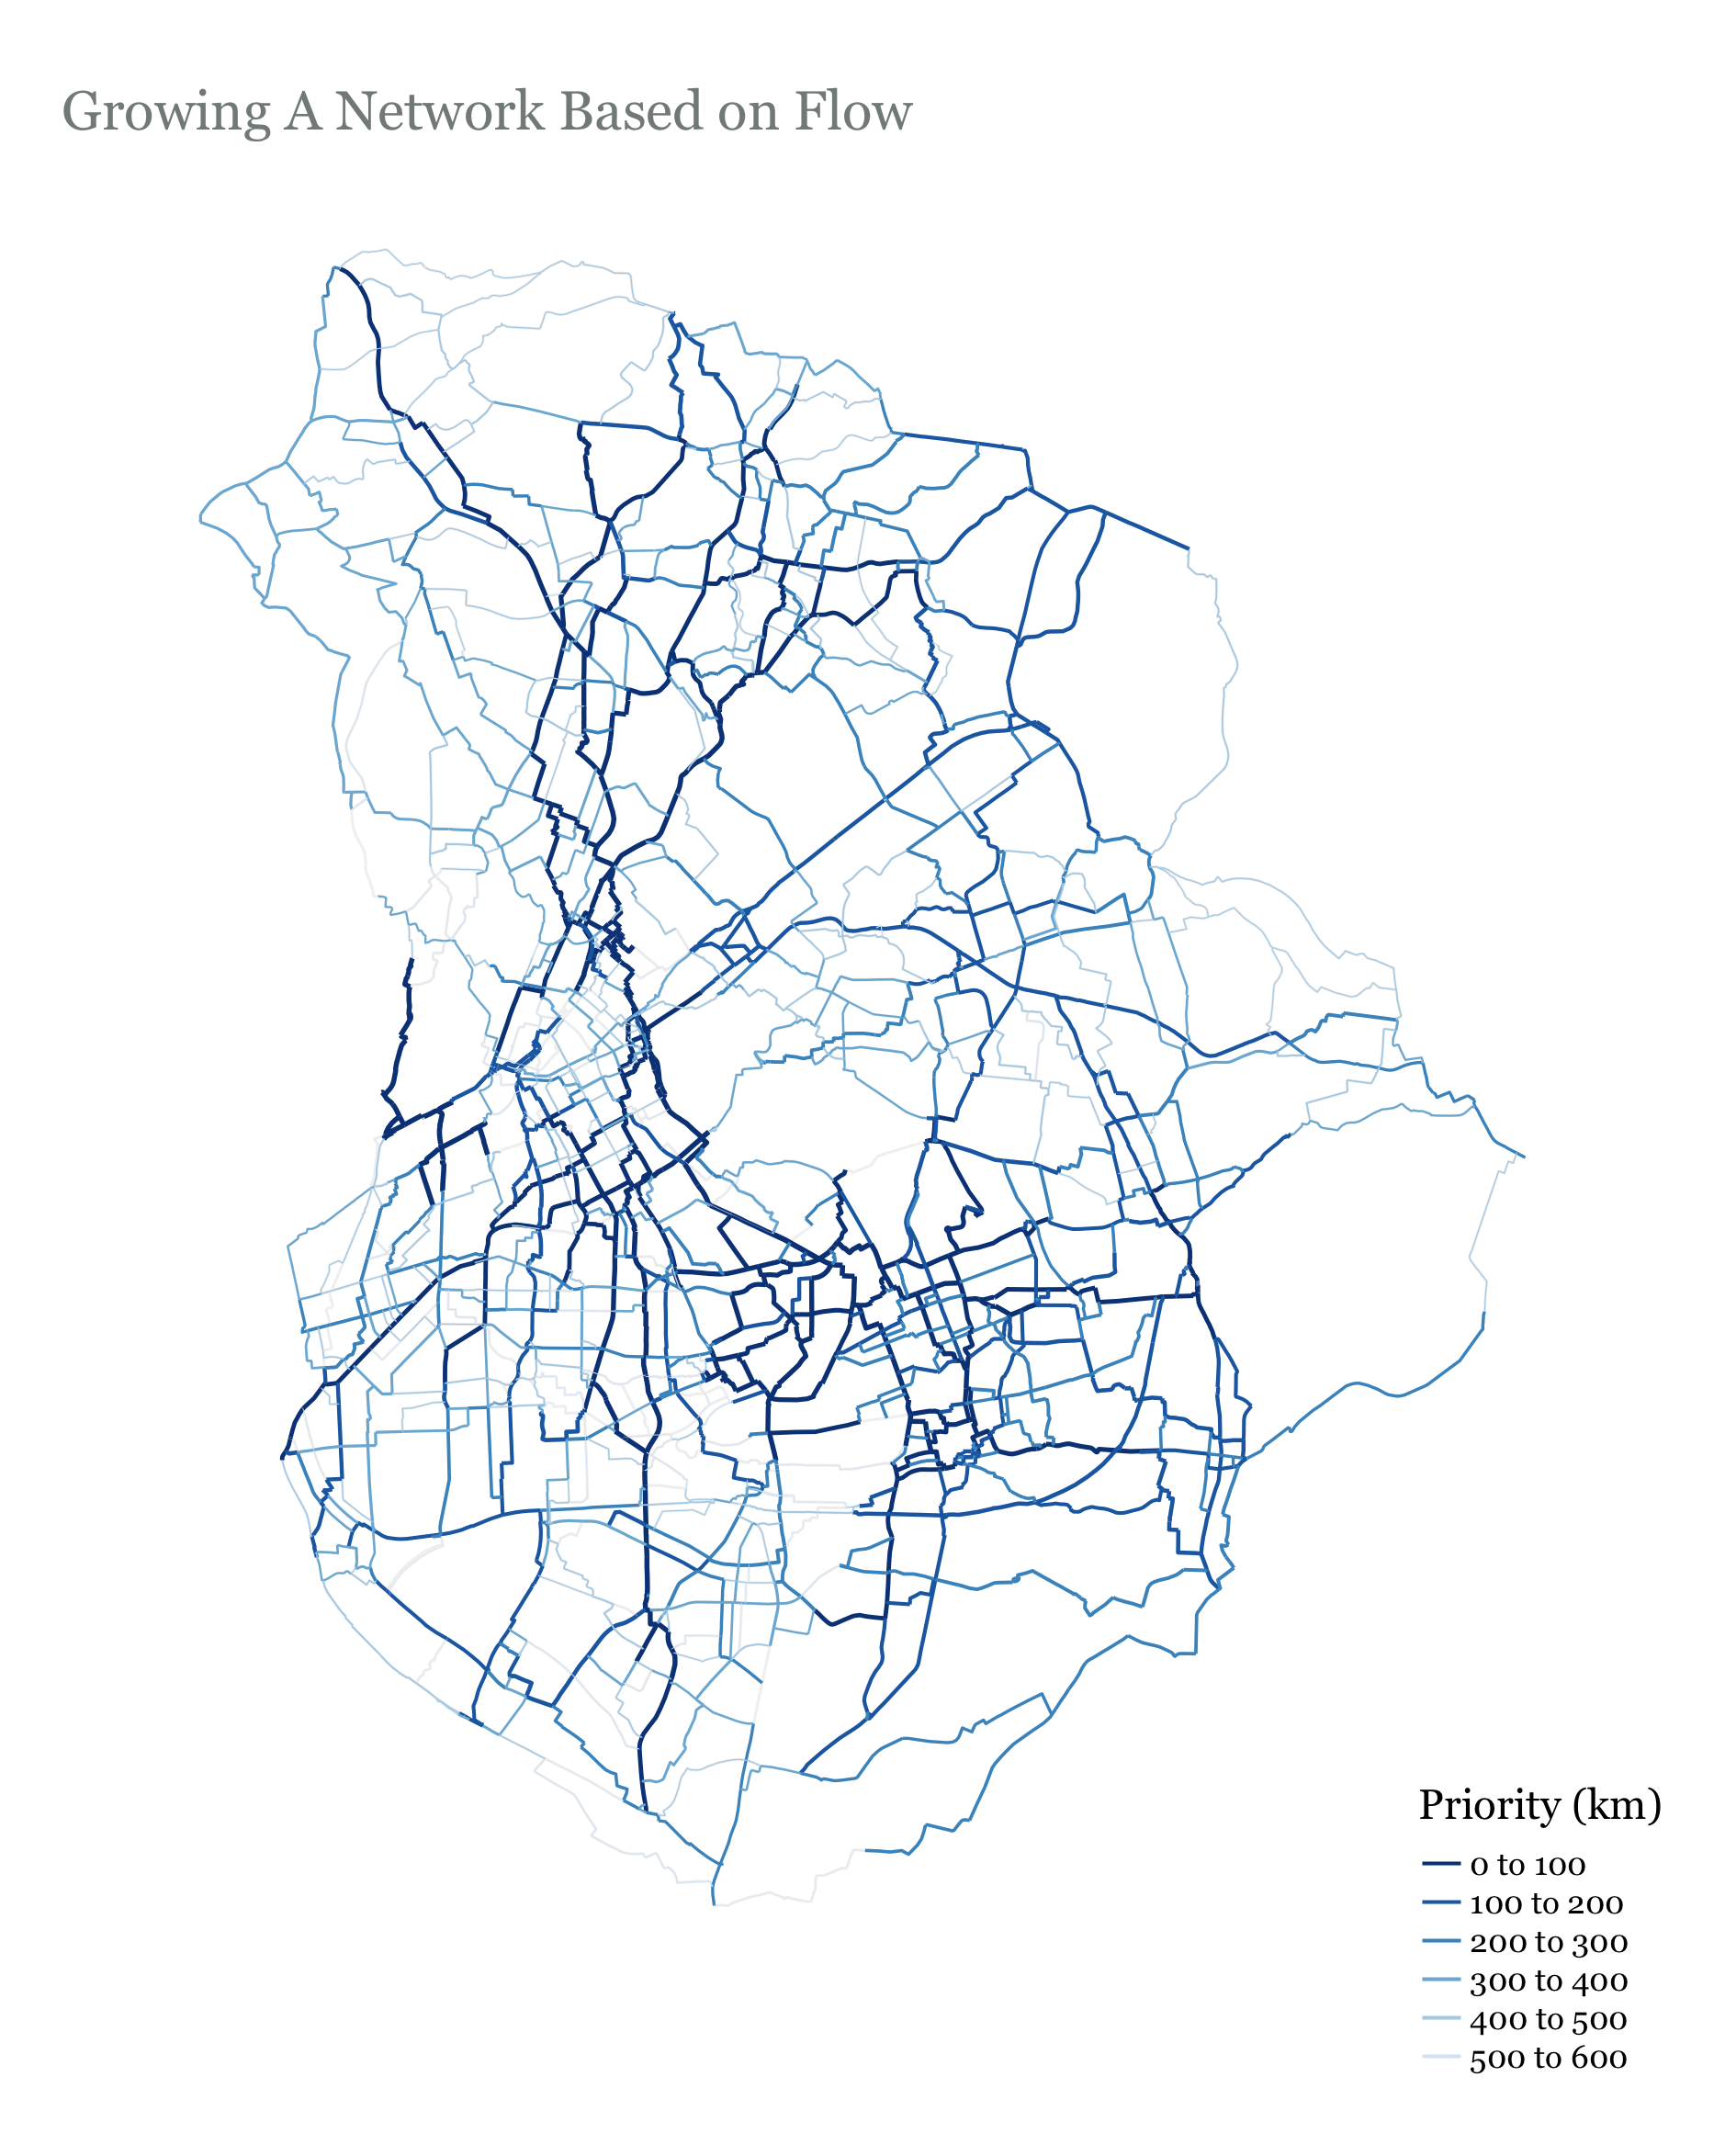
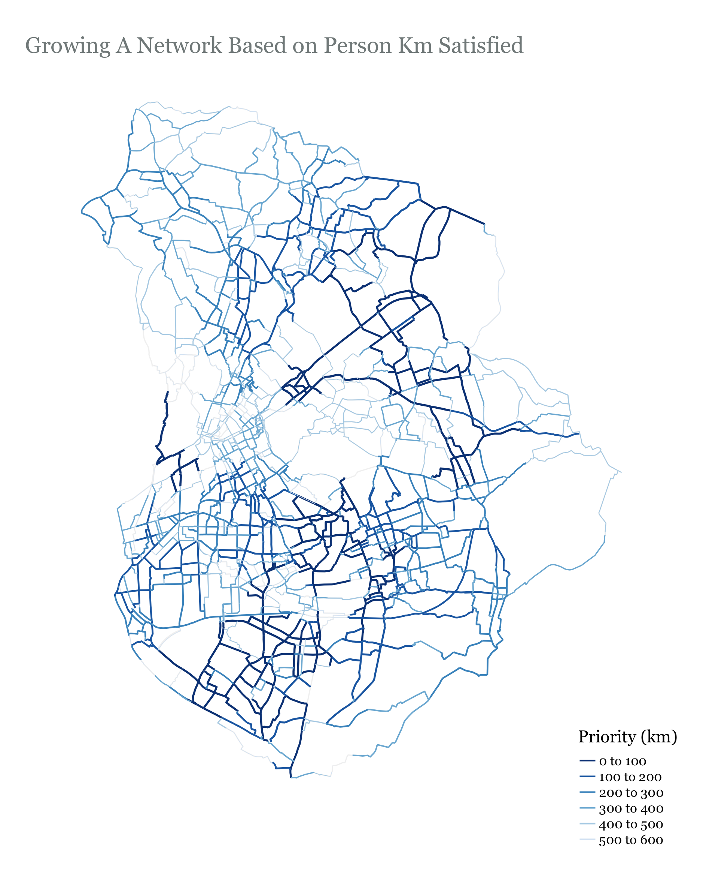

Slide 42
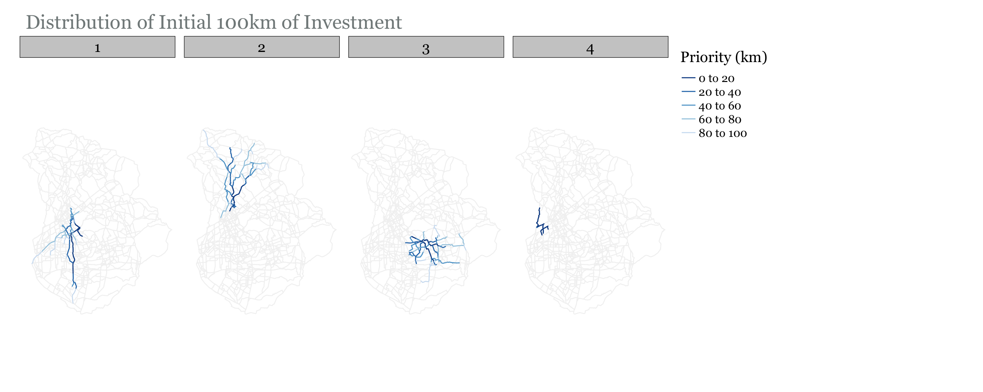
Growth shared between communities…

Slide 43
Notes
Growth is distributed more fairly
We are still not considering existing infrastructure
It seems that prioritizing based on flow is better.
Segments in the center are shorter so they are not selected early when prioritizing base on person_km (See the right figure in facet map on slide 41 – center is hollow)

Slide 44
Function 4 – Growth Based On Existing Infrastructure AND Shared Between Communities
Select investment length (km)
Identify edge with highest flow in each community
Identify all edges that have designated cycle infrastructure
Get union of 2 & 3. This ensures that we start with at least one edge from each community
For edges in each community
identify edges that neighbor the edges in the solution from that community
Select edge with highest flow from [a] and append it to the solution
Keep looping over the communities and selecting edges until you reach the investment length

Slide 45
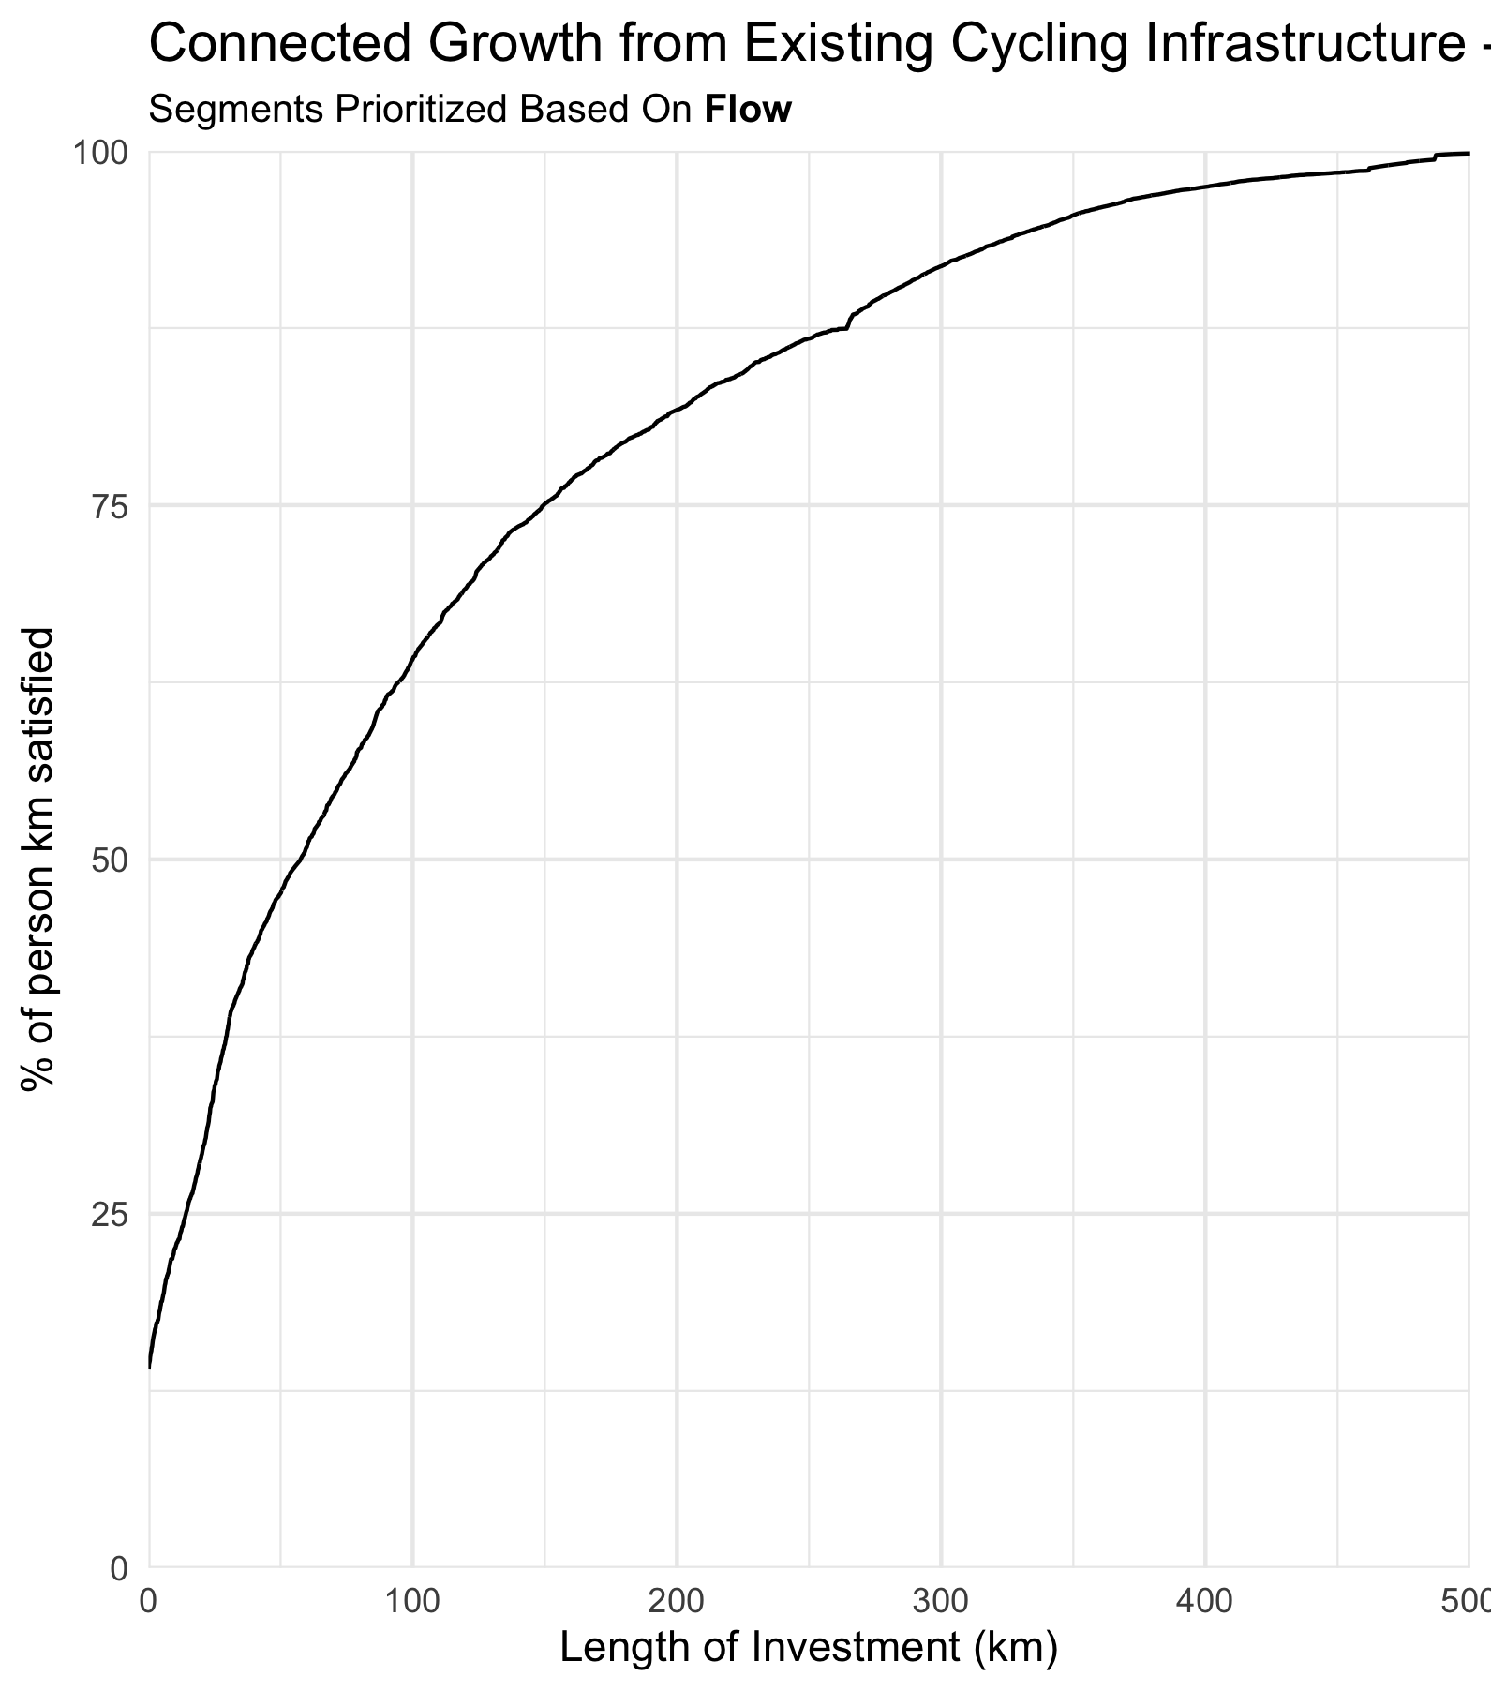
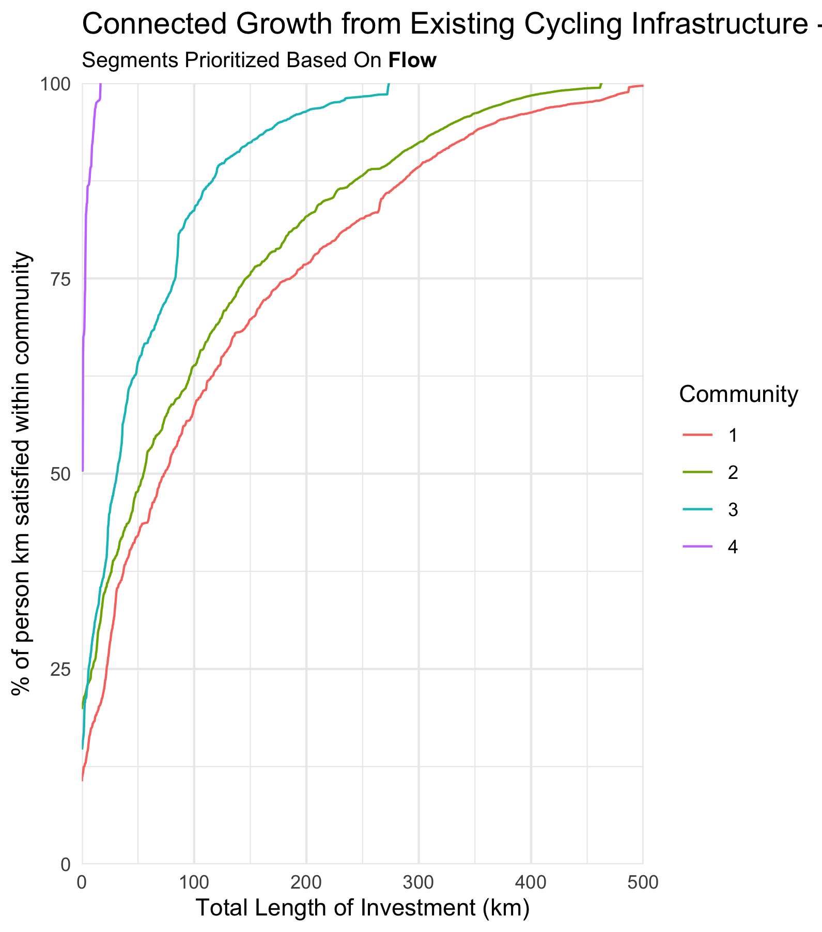

Slide 46
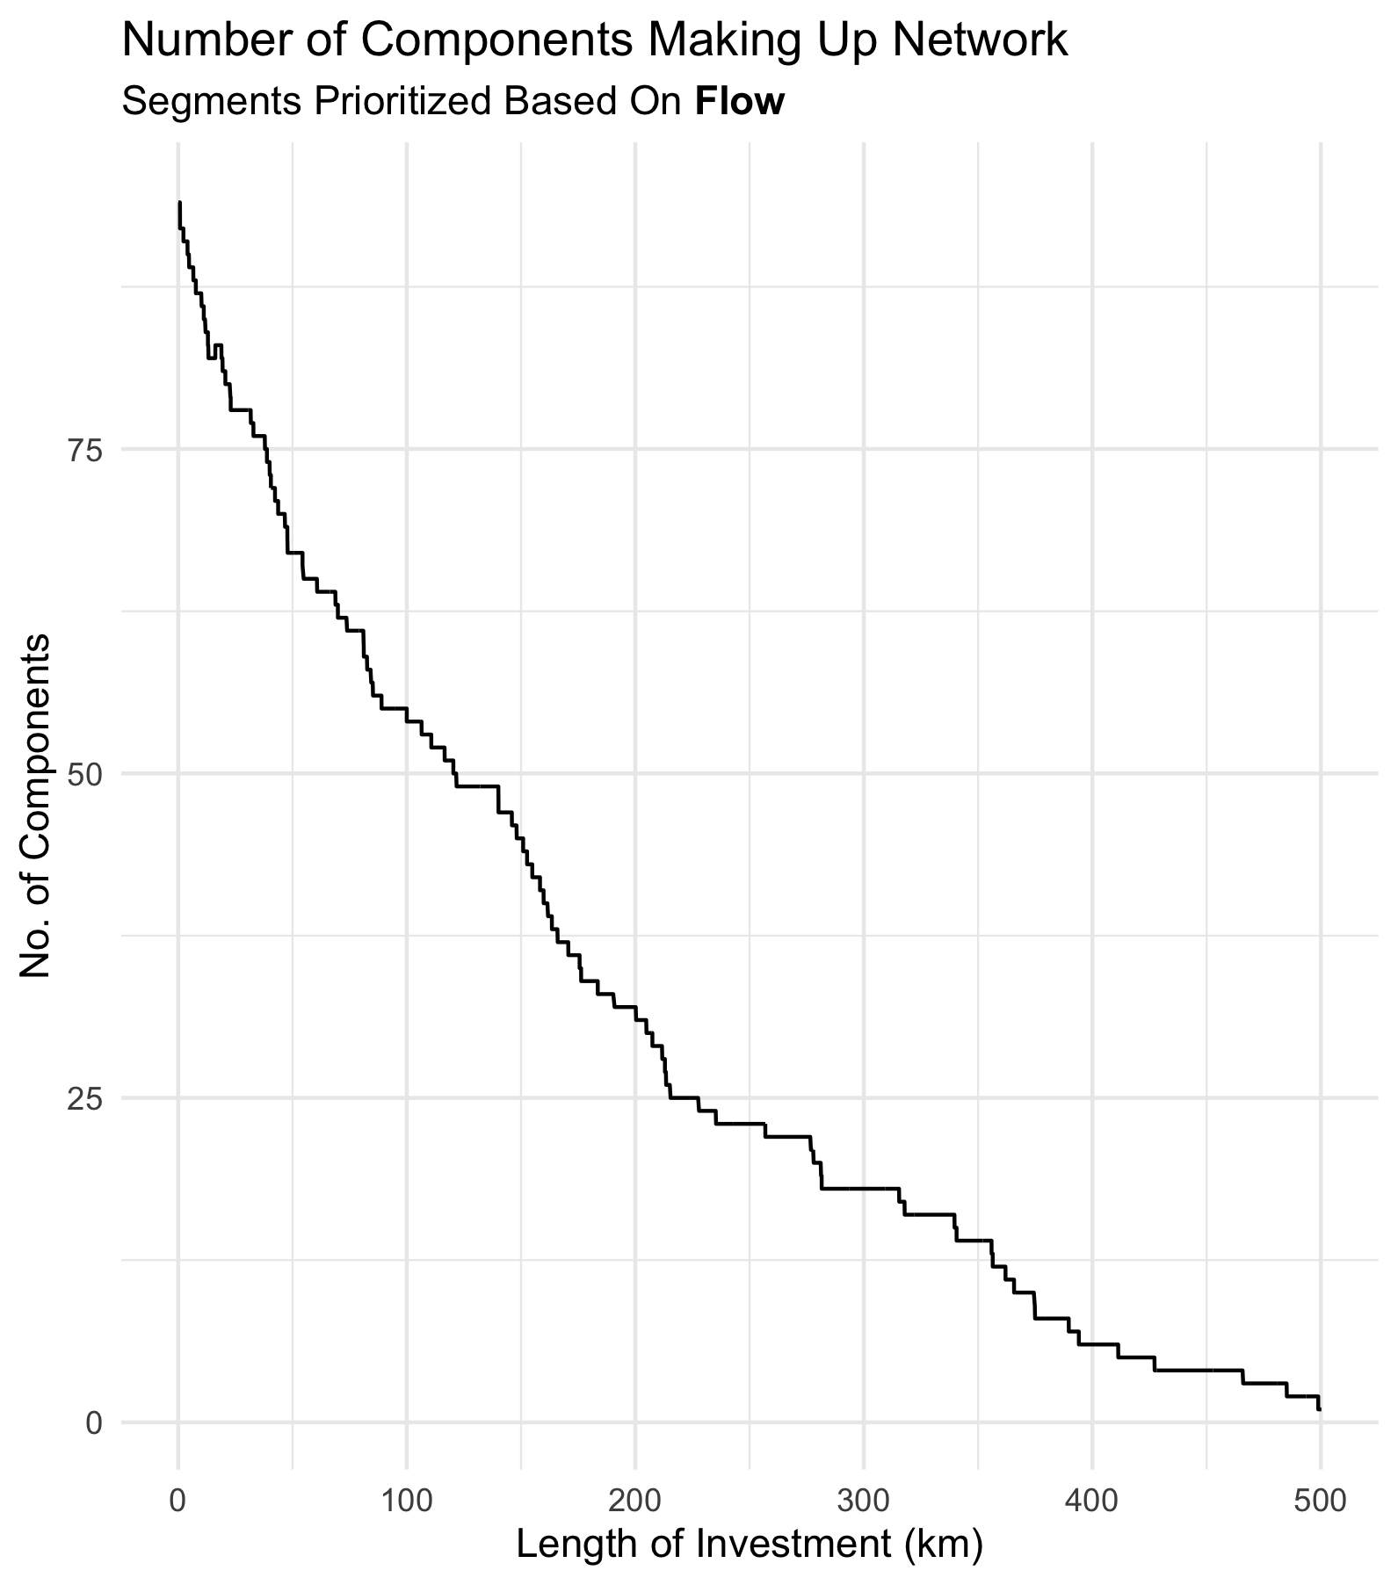
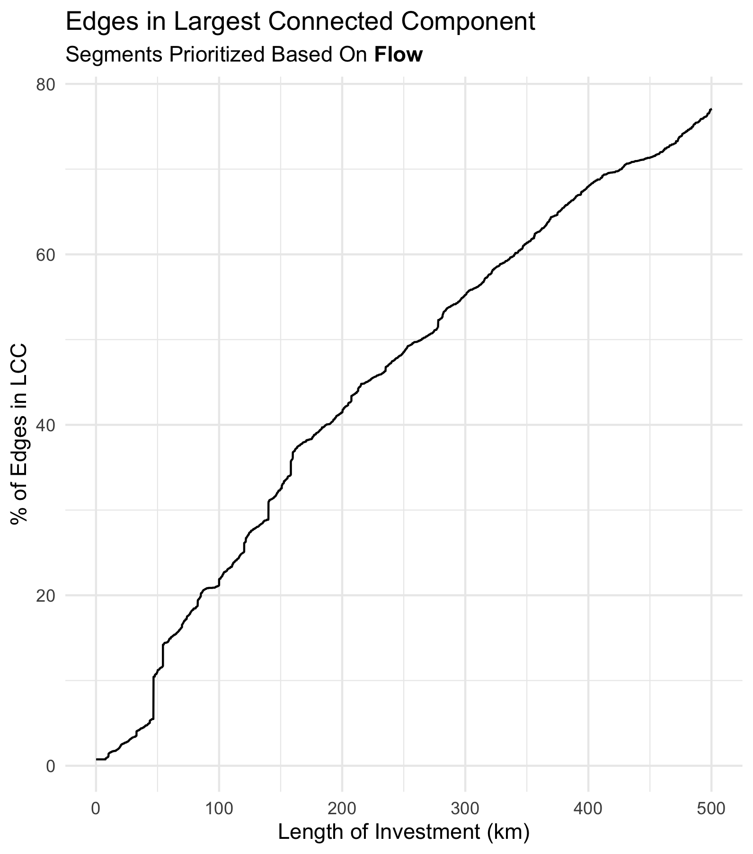

Slide 47
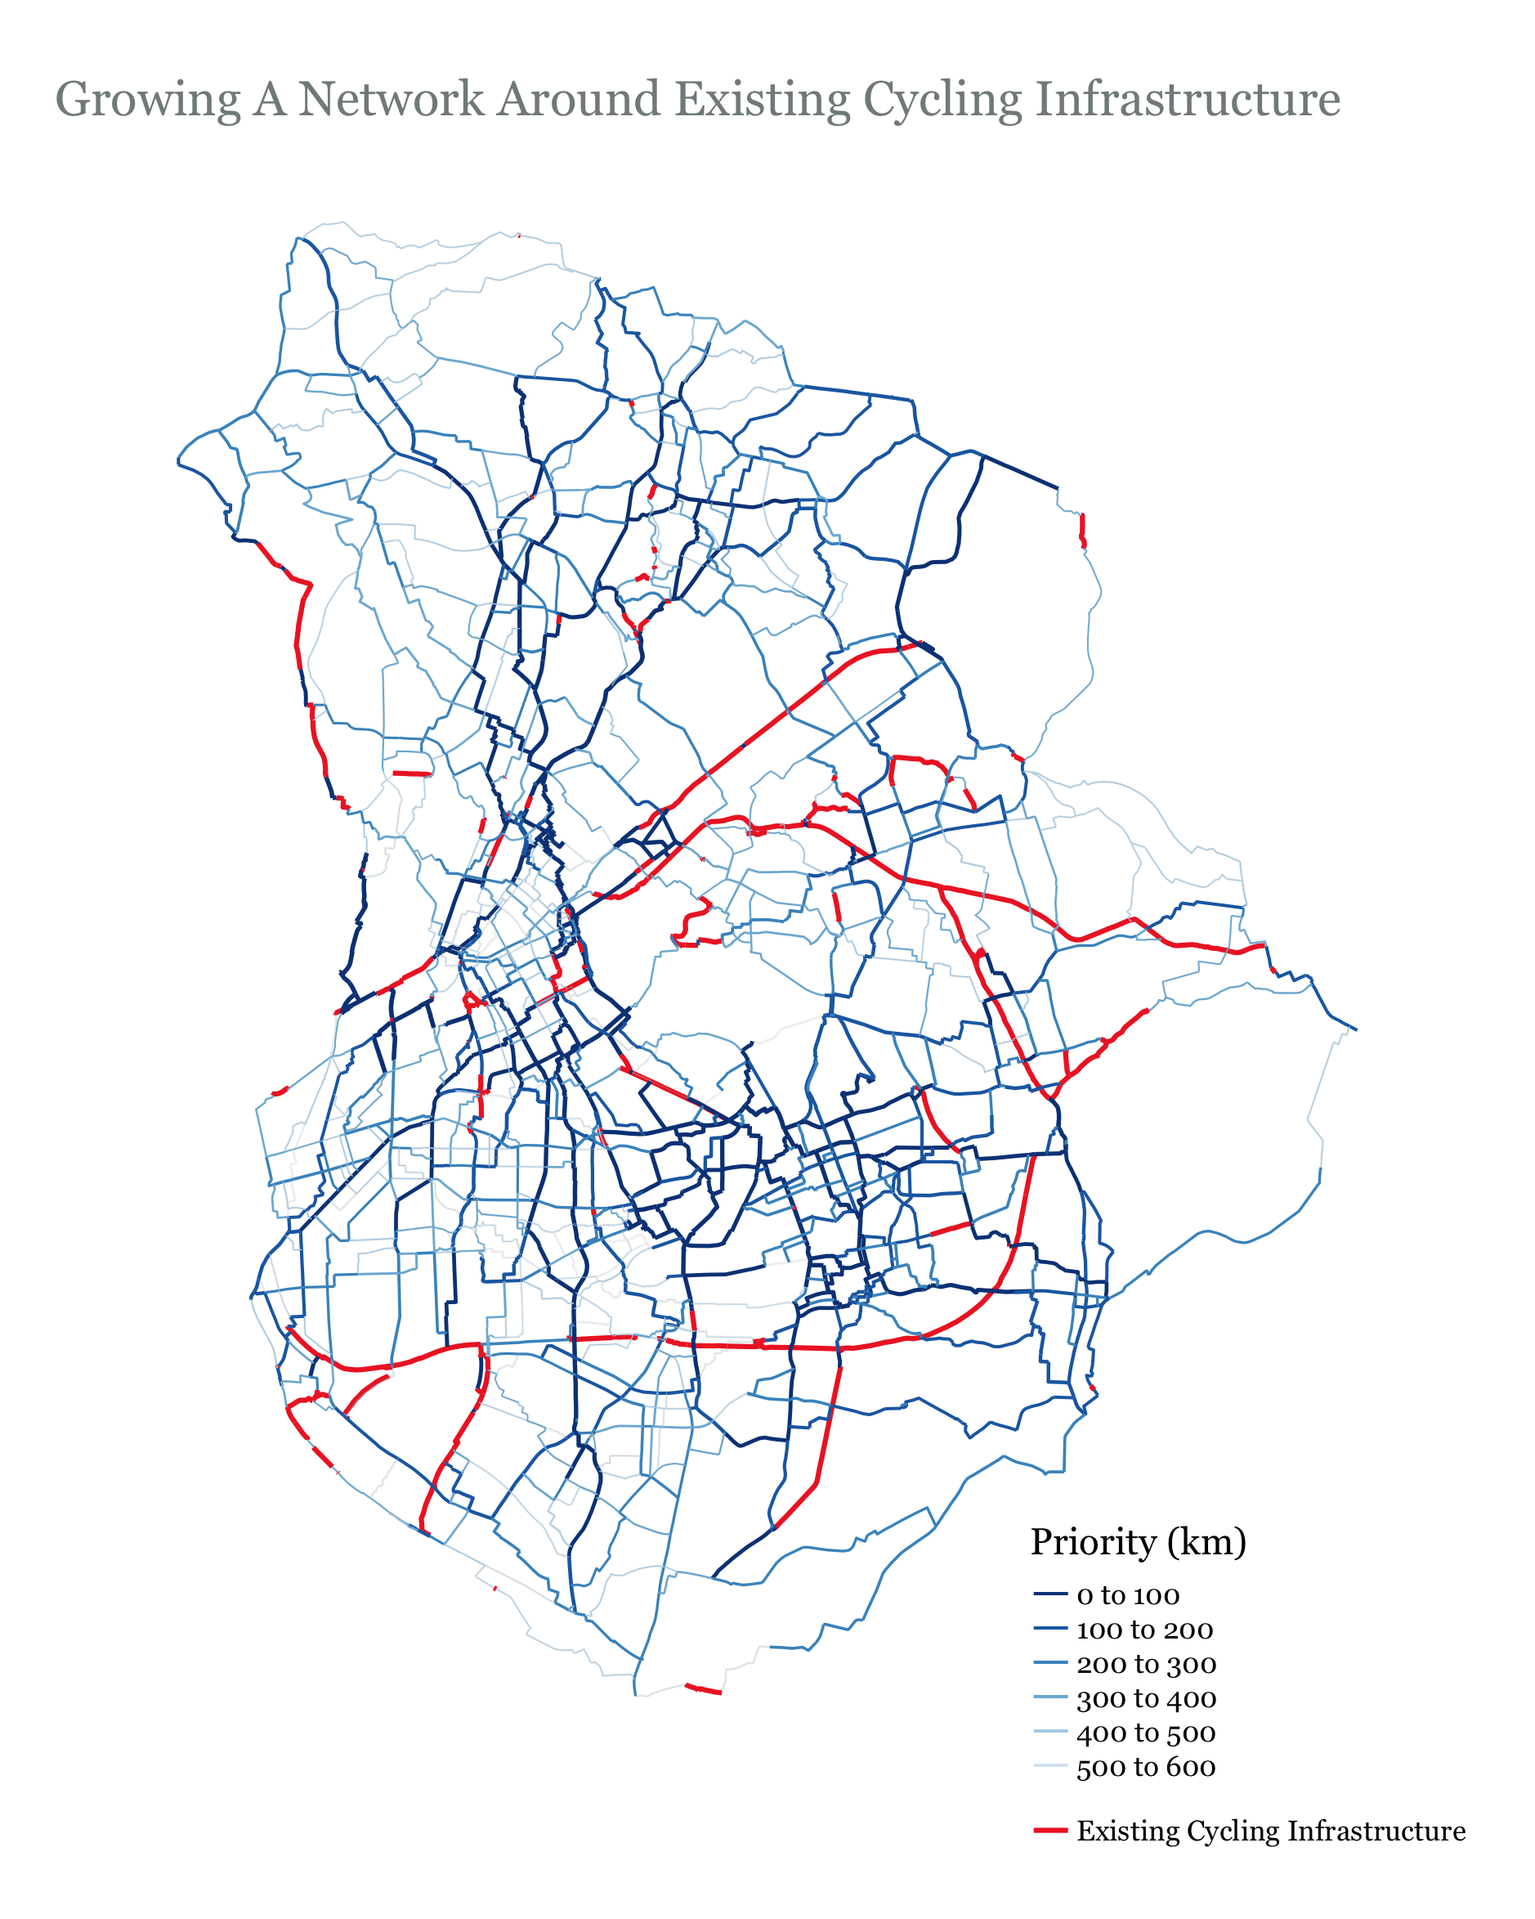

Slide 48
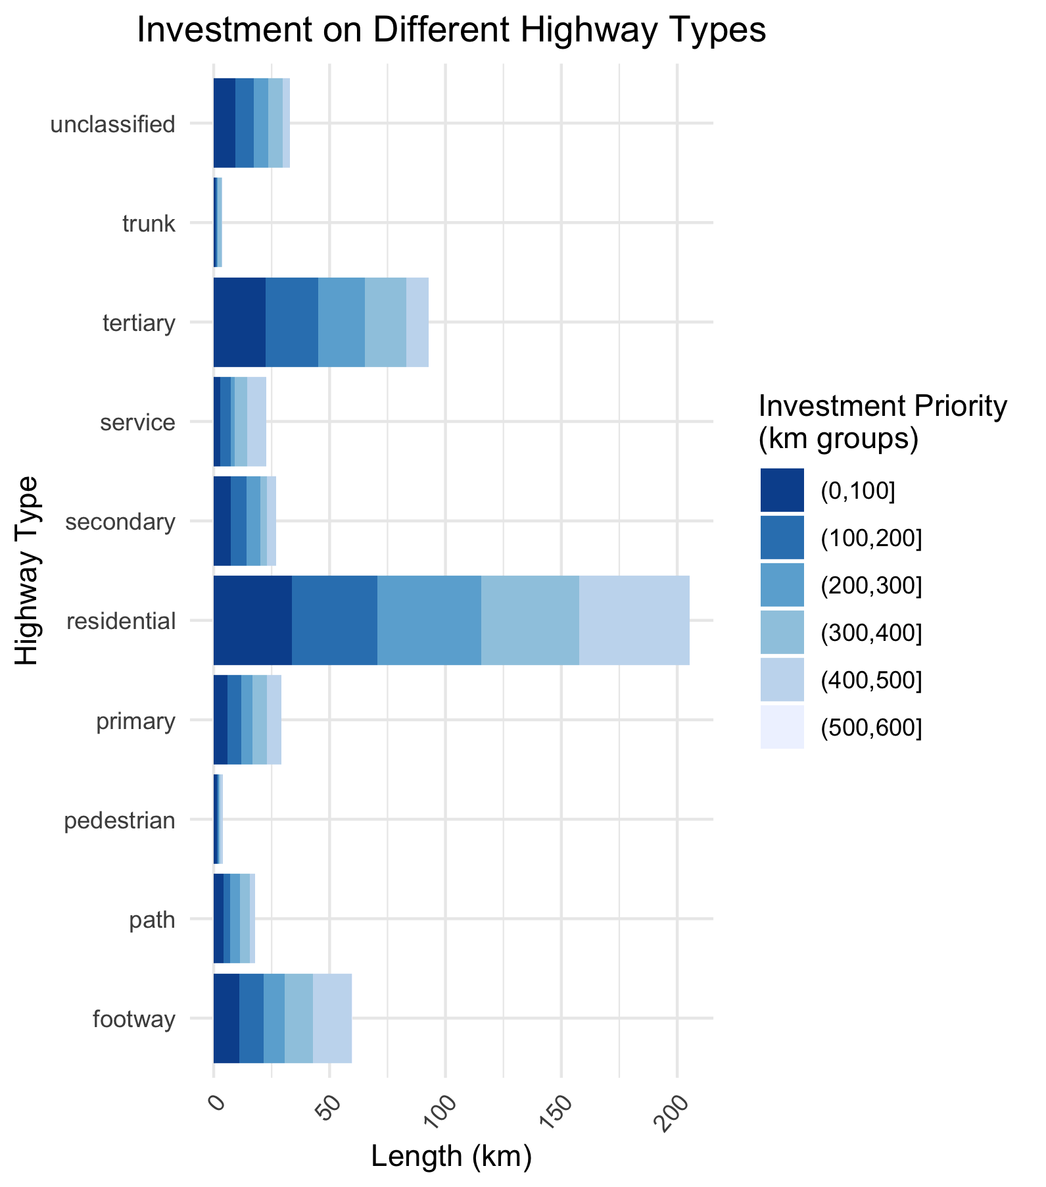

Slide 49
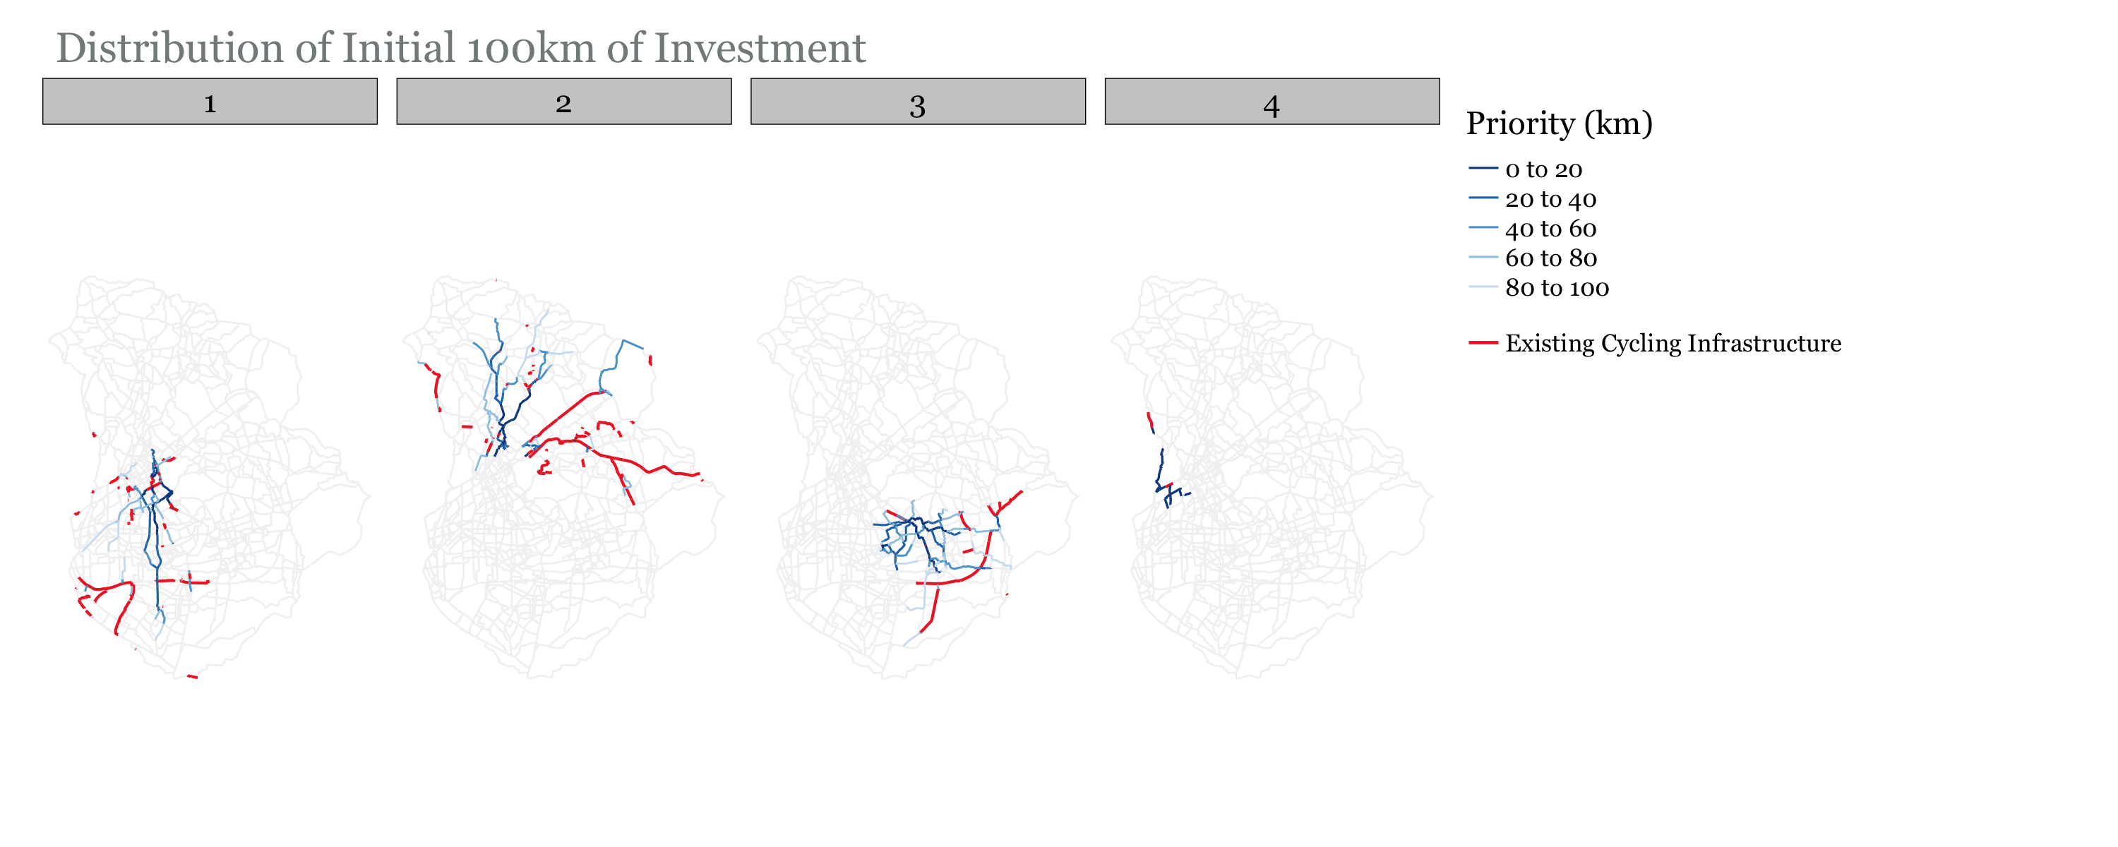
Growth shared between communities…

Slide 50

FINAL NOTES
TO DO
Revise potential demand prediction
Do I need to look more into community detection? It is only a means to an end, with the end being splitting up the study area.
How to prioritize road segments. I am doing it based on flow
Try and get length in LCC as opposed to number of edges in LCC
Not sure what else

